Slide 1
Slot Machine
RIGHT
PRESS THE RIGHT KEY TO CONTINUE

Slide 2
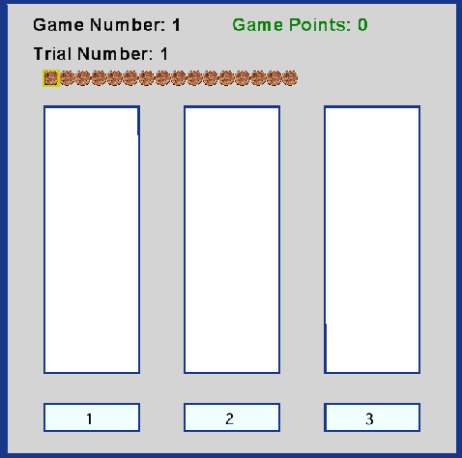
For this task, you will play 20 investment games in total. The goal is to earn as much money as possible.
LEFT
RIGHT
PRESS THE RIGHT KEY TO CONTINUE

Slide 3
In each game, you have 16 tokens (stacked in a row at the top of the screen) and 3 lotteries (the vertical white panels).
LEFT
RIGHT
PRESS THE RIGHT KEY TO CONTINUE

Slide 4
1
2
3
You are to place each token in the lottery panel of your choice. To do that, press the “1”, “2”, or “3” button that corresponds to the desired lottery panel.
LEFT
RIGHT
PRESS THE RIGHT KEY TO CONTINUE
Notes:
Replace screen shot with one where the cursor is over one of the buttons (e.g., over the 2).

Slide 5
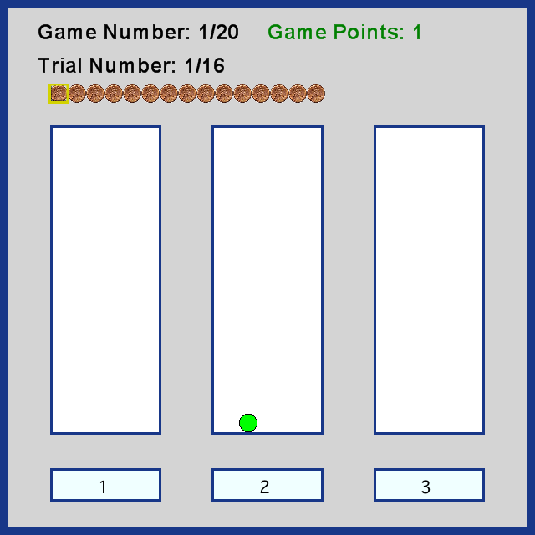
After each token placement, the token will turn green if you won (as shown). You earn 1 point for each green token.
LEFT
RIGHT
PRESS THE RIGHT KEY TO CONTINUE
Notes:
Replace screen shot with one where the button has been pressed (same button used in the last screenshot) and the result was a win…so that the token is green as indicated.

Slide 6
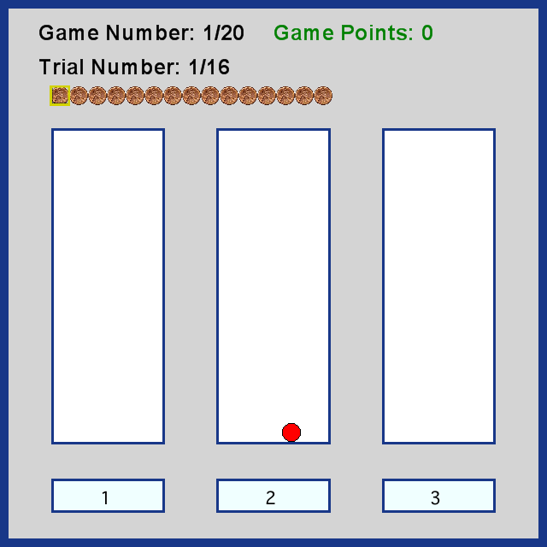
The token will turn red if you lost (as shown).
LEFT
RIGHT
PRESS THE RIGHT KEY TO CONTINUE
Notes:
Replace screen shot with one where the button has been pressed (same button used in the last screenshot) and the result was a loss…so that the token is red as indicated.

Slide 7
Some lotteries are more rewarding than others.
Each lottery will be replaced at the beginning of a new game.
LEFT
RIGHT
PRESS THE RIGHT KEY TO CONTINUE

Slide 8
Therefore, you need to get a sense of which lotteries are better for each new game.
LEFT
RIGHT
PRESS THE RIGHT KEY TO CONTINUE

Slide 9
Try to earn as many points as possible!
Remember that you will be paid
based on the total number of points you earn!
LEFT
RIGHT
PRESS THE RIGHT KEY TO CONTINUE

Slide 10
Press the RIGHT key when you are ready to begin.
LEFT
RIGHT
PRESS THE RIGHT KEY TO CONTINUE
Notes:
Outside the scanner

Slide 11
MOVING DOTS
RIGHT
PRESS THE RIGHT KEY TO CONTINUE

Slide 12
For this task, there will be one practice session with 30 trials. You will need to pass the practice session with 75% accuracy to begin the main experiment.
In the main experiment, there are 4 “blocks” of trials, each lasting about 5 minutes. In between each block, you will be able to take a brief break and be given feedback on your performance during that block.
LEFT
RIGHT
PRESS THE RIGHT KEY TO CONTINUE
Notes:
Change the “about 5 minutes” if this is not correct. I should also run this by Martin to make sure he is ok with how I changed the instructions.

Slide 13
In each trial, you will see three patches of moving dots: one is the target, containing dots moving primarily to the LEFT.
The other two are distractors, moving in the opposite direction. You are to locate the target as quickly as possible.
LEFT
RIGHT
PRESS THE RIGHT KEY TO CONTINUE

Slide 14
In each trial, you will see three patches of moving dots: one is the target, containing dots moving primarily to the RIGHT.
The other two are distractors, moving in the opposite direction. You are to locate the target as quickly as possible.
LEFT
RIGHT
PRESS THE RIGHT KEY TO CONTINUE

Slide 15

At the beginning of each trial, there will be an “X” at the center of the screen (as shown below). Please focus your eyes on that cross each time it is displayed.
+
LEFT
RIGHT
PRESS THE RIGHT KEY TO CONTINUE
Notes:
A real screenshot of the fixation would be best here.

Slide 16
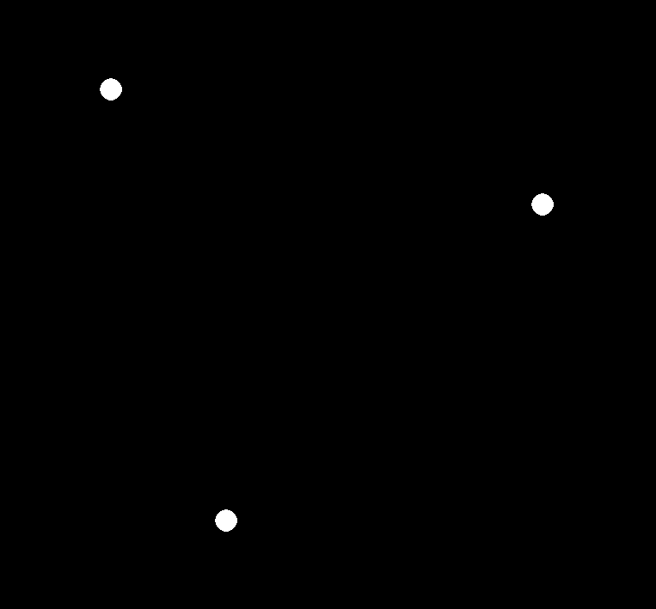
After the cross disappears, three white dots will appear on the screen (as shown below).
LEFT
RIGHT
PRESS THE RIGHT KEY TO CONTINUE
Notes:
I have no idea if these dots look anything like what they will in the task. Probably best to get a screenshot ☺

Slide 17
You will need to “open” the patch at each dot to observe the direction of its movement. To “open” each patch, you are to press the keys that correspond to the dots location.
Press the “LEFT” arrow key to “open” the patch in the upper left of the screen.
Press the “DOWN” arrow key to open the patch in the bottom of the screen.
Press the “RIGHT” arrow key to open the patch in the middle right of the screen.
LEFT
RIGHT
PRESS THE RIGHT KEY TO CONTINUE

Slide 18
For example, if you hit the “DOWN” arrow, this is what the screen might look like.
Notice that this patch is a DISTRACTOR, as the dots are moving to the RIGHT
LEFT
RIGHT
PRESS THE RIGHT KEY TO CONTINUE
Notes:
Include screenshot here, with arrows indicating direction of the dots. If you could actually have an animated GIF, that would be sweet ☺

Slide 19
For example, if you hit the “DOWN” arrow, this is what the screen might look like.
Notice that this patch is a DISTRACTOR, as the dots are moving to the LEFT
LEFT
RIGHT
PRESS THE RIGHT KEY TO CONTINUE
Notes:
Include screenshot here, with arrows indicating direction of the dots. If you could actually have an animated GIF, that would be sweet ☺

Slide 20
Your task on each trial is to find the target (which is the patch with dots moving to the LEFT).
When you decide the patch you are looking at is the target, press the UP KEY.
LEFT
RIGHT
PRESS THE RIGHT KEY TO CONTINUE

Slide 21
Your task on each trial is to find the target (which is the patch with dots moving to the RIGHT).
When you decide the patch you are looking at is the target, press the UP KEY.
LEFT
RIGHT
PRESS THE RIGHT KEY TO CONTINUE

Slide 22
For example, if you hit the “RIGHT” arrow, this is what the screen might look like.
Notice that this patch is a TARGET, as the dots are moving to the LEFT. In this case, you would want to hit the UP KEY.
LEFT
RIGHT
PRESS THE RIGHT KEY TO CONTINUE
Notes:
Include screenshot here, with arrows indicating direction of the dots. If you could actually have an animated GIF, that would be sweet ☺

Slide 23
For example, if you hit the “RIGHT” arrow, this is what the screen might look like.
Notice that this patch is a TARGET, as the dots are moving to the RIGHT. In this case, you would want to hit the UP KEY.
LEFT
RIGHT
PRESS THE RIGHT KEY TO CONTINUE
Notes:
Include screenshot here, with arrows indicating direction of the dots. If you could actually have an animated GIF, that would be sweet ☺

Slide 24
If you respond correctly, you will hear a crisp beep and the correct target will turn green, as shown on the next screen.
LEFT
RIGHT
PRESS THE RIGHT KEY TO CONTINUE

Slide 25
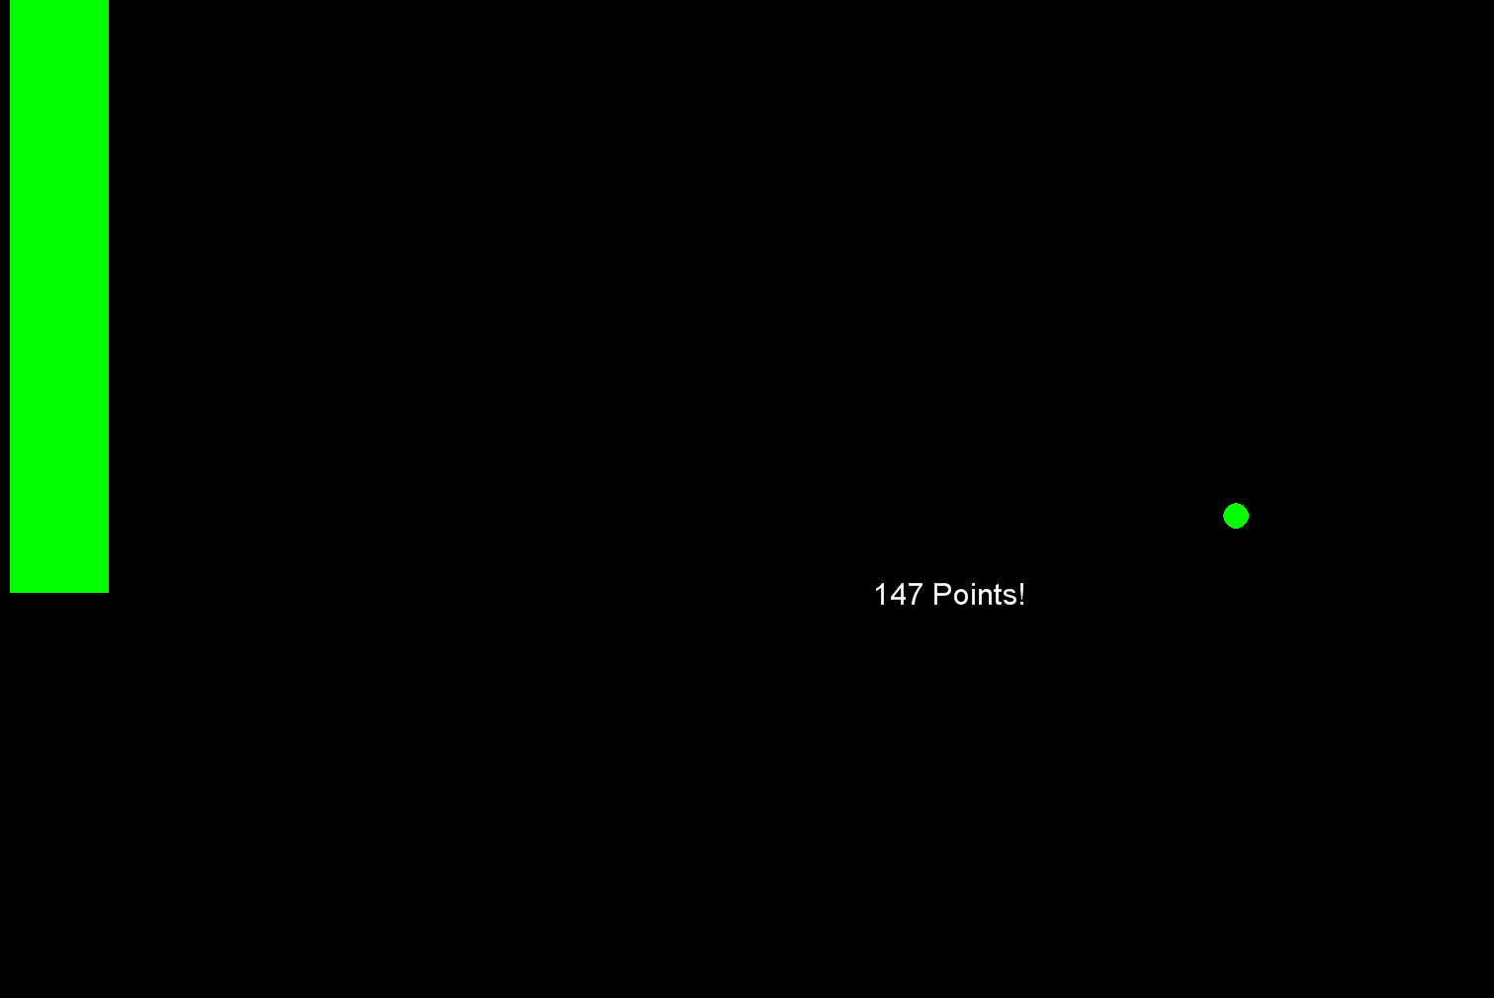
LEFT
RIGHT
PRESS THE RIGHT KEY TO CONTINUE
Notes:
Include screenshot here, with the correct patch shown in green and the beep sound. If you could actually have an animated GIF, that would be sweet ☺

Slide 26
If you respond incorrectly, you will hear a dull beep and the correct target will turn red, as shown on the next screen.
LEFT
RIGHT
PRESS THE RIGHT KEY TO CONTINUE

Slide 27
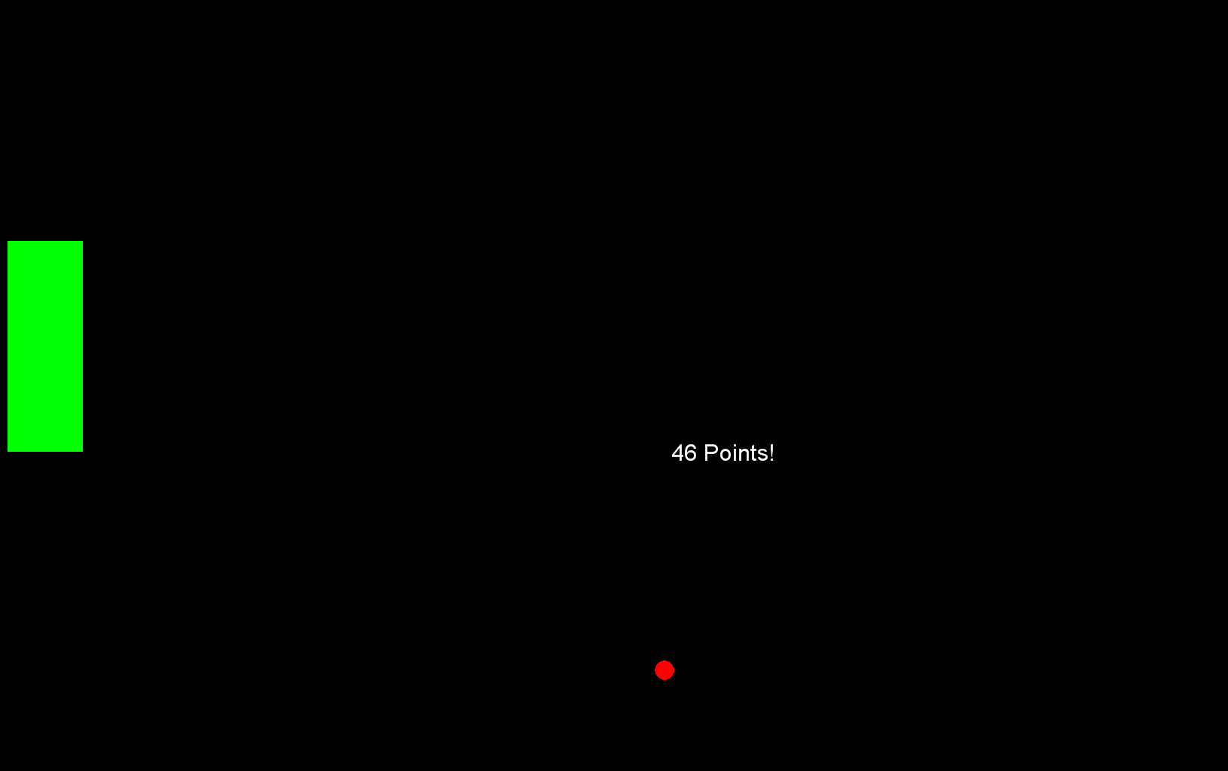
LEFT
RIGHT
PRESS THE RIGHT KEY TO CONTINUE
Notes:
Include screenshot here, with the correct patch shown in red and the beep sound. If you could actually have an animated GIF, that would be sweet ☺

Slide 28
If you respond TOO quickly after you uncover a patch, you will hear the dull beep twice in quick succession and will have a time-out penalty of 4 seconds. This is demonstrated in the next two slides.
LEFT
RIGHT
PRESS THE RIGHT KEY TO CONTINUE
Notes:
In the next 2 slides, have a screen shot of the patches with the two dull beeps sounding…and then go to the timeout screen for 4 seconds.

Slide 29
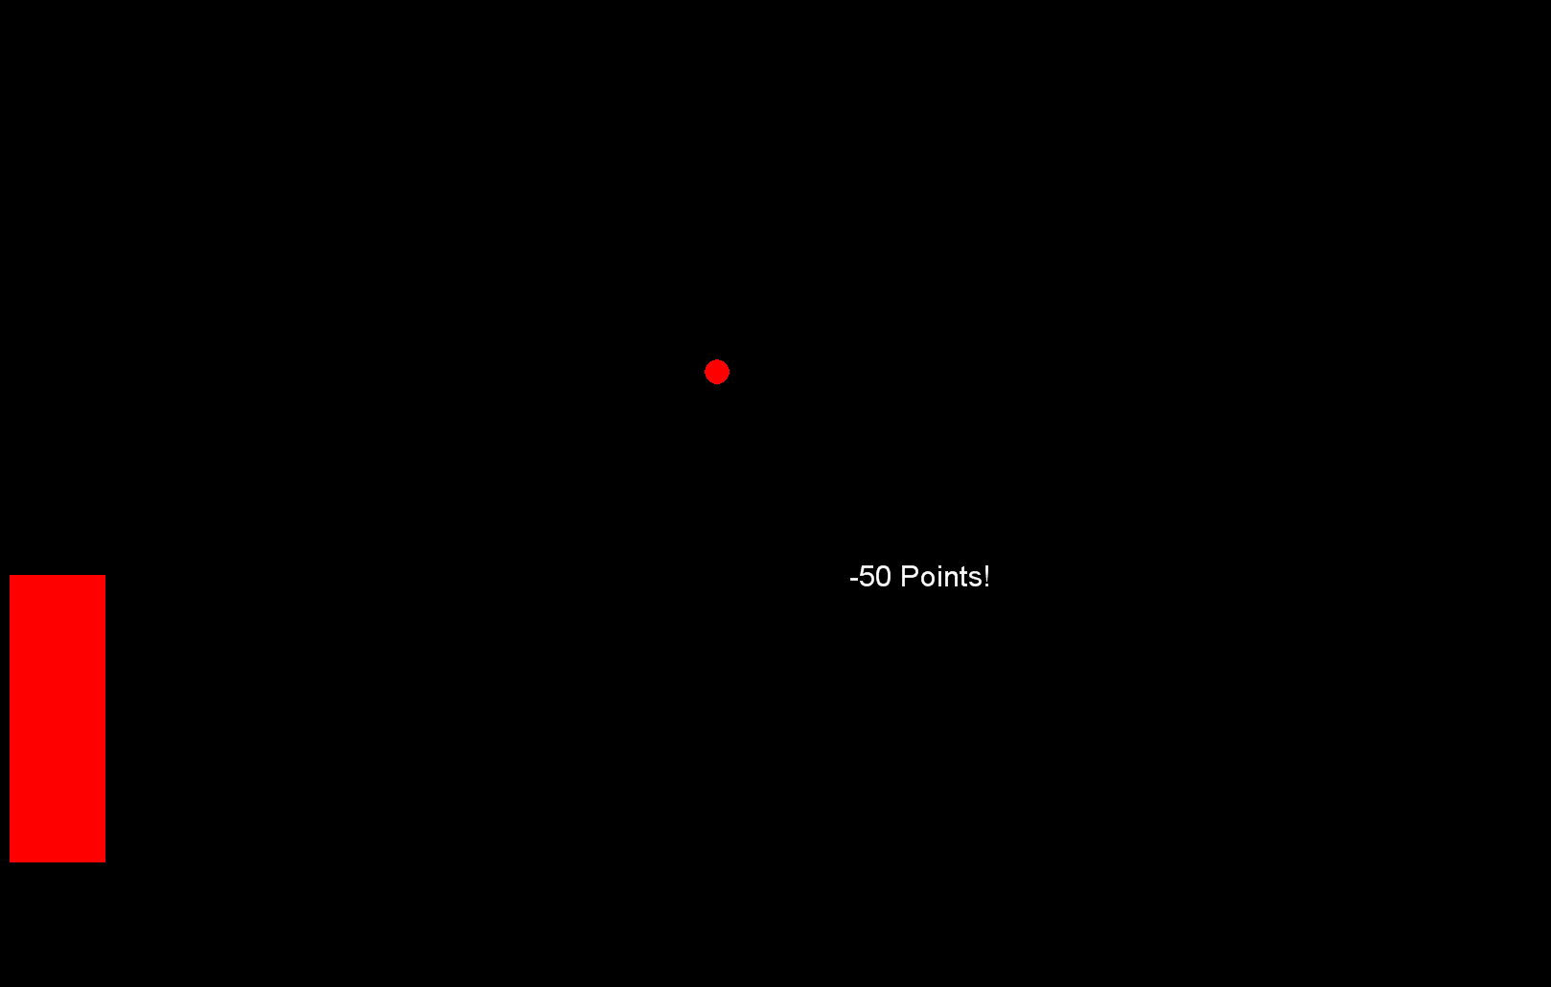
Placeholder: Screenshot with two dull beeps.

Slide 30

Placeholder: Screenshot of timeout screen.

Slide 31
For this task, you will be paid based on the total number of points you earn.
SCORING:
A total of 100 points will be given at the beginning of each trial.
12.5 penalty points per second will be subtracted from the 100 point total as time elapses. There is no time limit so it will keep subtracting points until you respond: which means you can have negative points.
There is also a SWITCH-COST of 25 points every time you open a new patch. So, every time you move to a different patch, 25 points will be subtracted from your total score.
The remaining points will be your score on that trial, plus an extra 50 points if you respond correctly, or minus 50 points if you respond incorrectly.
LEFT
RIGHT
PRESS THE RIGHT KEY TO CONTINUE

Slide 32
There will be a timing bar on the left side of the screen
to indicate how many points you have left.
Green means there are positive points
remaining from the original 100 points.
Red means there are negative points
remaining from the original 100 points.
LEFT
RIGHT
PRESS THE RIGHT KEY TO CONTINUE

Slide 33
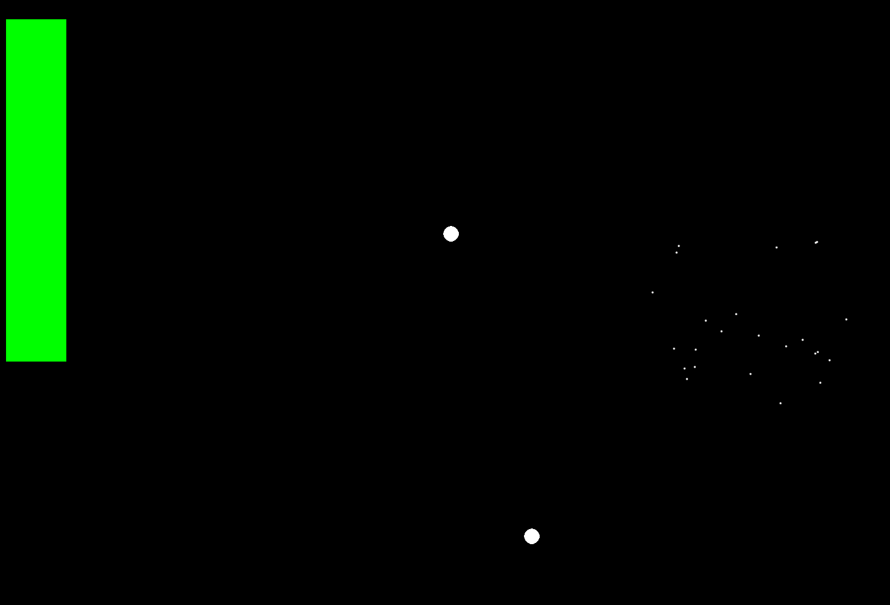
An example of the timing bar when there are
positive points is shown here.
LEFT
RIGHT
PRESS THE RIGHT KEY TO CONTINUE
Notes:
Past in a screen shot of the task with the timing bar in green.

Slide 34
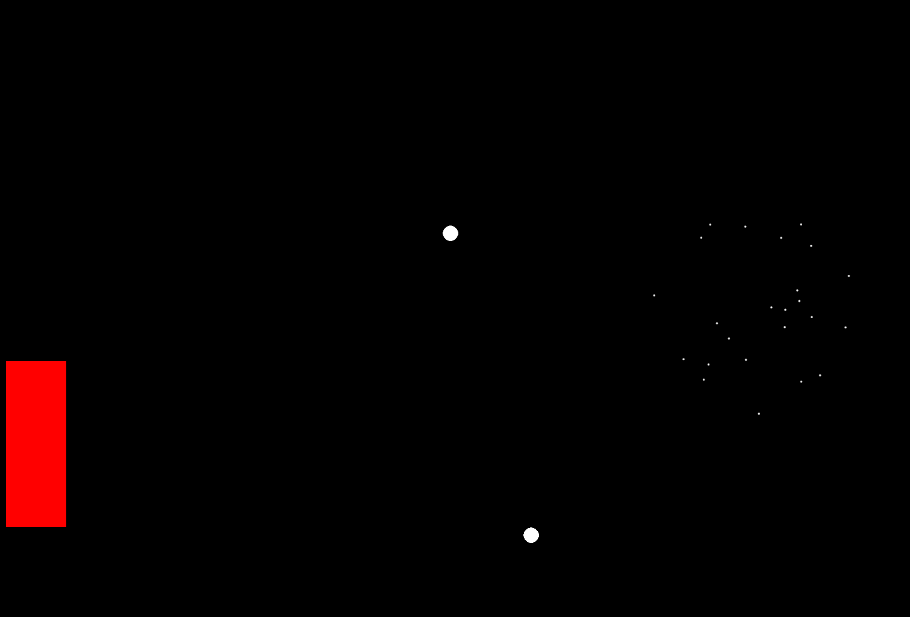
An example of the timing bar when there are negative points is shown here.
LEFT
RIGHT
PRESS THE RIGHT KEY TO CONTINUE
Notes:
Past in a screen shot of the task with the timing bar in red.

Slide 35
The timing bar will keep growing until it reaches the bottom of the screen, but it will keep subtracting your points at the same rate.
If you switch patches, the switch cost will be reflected by a sudden drop in the timing bar. After your response, your reward or penalty points will also be reflected in the timing bar.
LEFT
RIGHT
PRESS THE RIGHT KEY TO CONTINUE

Slide 36
Please try to respond as quickly and
accurately as you can on each trial.
NOTE: Please use any strategy you need to earn
as many points as you can.
Try to earn as many points as possible!
Remember, you will be paid based on the
total number of points you earn!
LEFT
RIGHT
PRESS THE RIGHT KEY TO CONTINUE

Slide 37
You will now complete the practice session. Remember, you must achieve a 75% accuracy before you may continue.
On each trial, you will indicate the location of your target by pressing the UP KEY when the target is open.
Remember your target is the patch moving to the LEFT.
LEFT
RIGHT
PRESS THE RIGHT KEY TO CONTINUE

Slide 38
You will now complete the practice session. Remember, you must achieve a 75% accuracy before you may continue.
On each trial, you will indicate the location of your target by pressing the UP KEY when the target is open.
Remember your target is the patch moving to the RIGHT.
LEFT
RIGHT
PRESS THE RIGHT KEY TO CONTINUE

Slide 39
Press the RIGHT key when you are ready to begin.
LEFT
RIGHT
PRESS THE RIGHT KEY TO CONTINUE
Notes:
Outside the scanner

Slide 40
DOT PROBE
RIGHT
PRESS THE RIGHT KEY TO CONTINUE

Slide 41
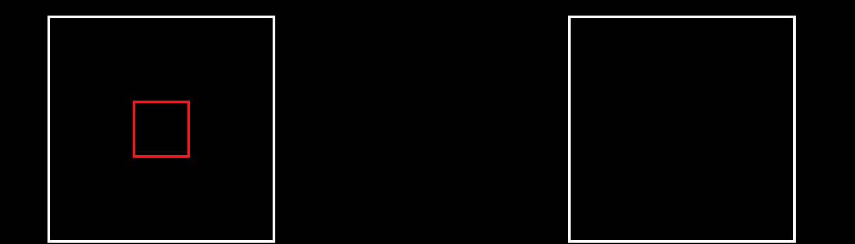
In this task, you will be presented with trials that have the following structure:
Each trial begins with the appearance of two white squares, one appearing just to the left and the other just to the right of the screen center.
Inside one of these white squares will be the outline of a smaller red square marking its central area. Please immediately focus your attention onto this smaller red square.
LEFT
RIGHT
PRESS THE RIGHT KEY TO CONTINUE

Slide 42
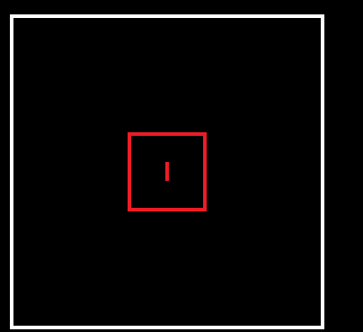
One second later you will see either a small red horizontal line or a small red vertical line.
This small line will appear for only a brief moment so be sure that you already have your attention in this screen region or you will miss seeing it.
What you must do is note the orientation of this briefly displayed small line and remember whether it is horizontal or vertical.
LEFT
RIGHT
PRESS THE RIGHT KEY TO CONTINUE

Slide 43
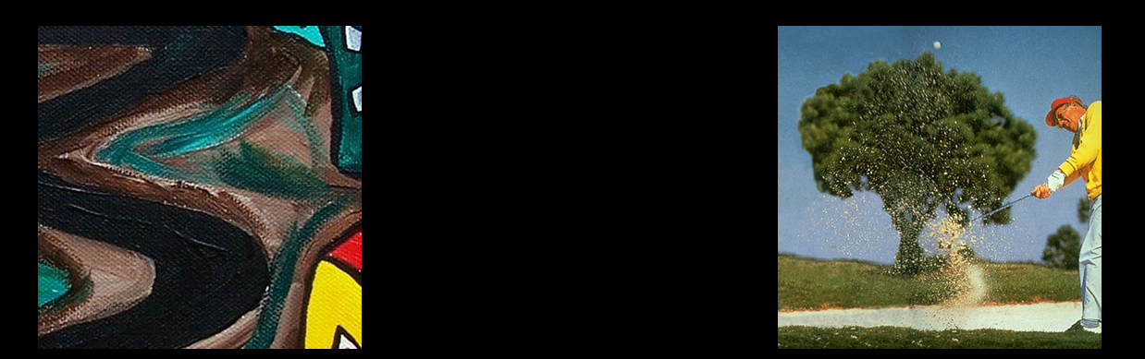
Immediately after the small line disappears, two images will appear in place of two larger white square outlines. No response is required to these images.
However, as soon as these images disappear, a second small red line will appear in the central region of either white square outline.
LEFT
RIGHT
PRESS THE RIGHT KEY TO CONTINUE

Slide 44
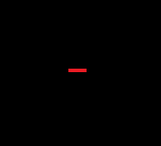
Again, this second line may be presented horizontally or vertically.
This second red line may be presented in the center of the same white square as the previous red line or in the center of the other white square. It does not matter which is the case, your task is the same regardless of where the second line appears.
Specifically, you must quickly decide whether the orientation of this second line matches the orientation of the first line.
LEFT
RIGHT
PRESS THE RIGHT KEY TO CONTINUE

Slide 45

Same Different
So if you decide that the two lines match (that they are both presented horizontally or both presented vertically) – then you should press the LEFT key.
If you decide that the two lines do NOT match (that one is presented horizontally and one is presented vertically) then you need to press the DOWN key.
LEFT
RIGHT
PRESS THE RIGHT KEY TO CONTINUE

Slide 46
Same Different
Should you make a mistake, the task will switch to an ‘error triggered delay’ which will count down for 3 seconds in order to allow you to collect your thoughts before beginning the next trial.
Please ensure that you respond as quickly as you can without sacrificing any accuracy in your responses.
We will start off with a practice to prepare you for the task.
LEFT
RIGHT
PRESS THE RIGHT KEY TO CONTINUE

Slide 47
Press the RIGHT key when you are ready to begin.
LEFT
RIGHT
PRESS THE RIGHT KEY TO CONTINUE
Notes:
Outside the scanner

Slide 48
Pictures and Sounds
RIGHT
PRESS THE RIGHT KEY TO CONTINUE

Slide 49
For the next part of the experiment, you will be looking
at different pictures and you will be rating each picture
in terms of how it made you feel while viewing it.
There are no right or wrong answers,
so simply respond as honestly as you can.
In between these images,
please focus on the cross (“+”) in the middle of the screen.
At certain times during this task,
you may also hear loud sounds through your headphones.
LEFT
RIGHT
PRESS THE RIGHT KEY TO CONTINUE

Slide 50
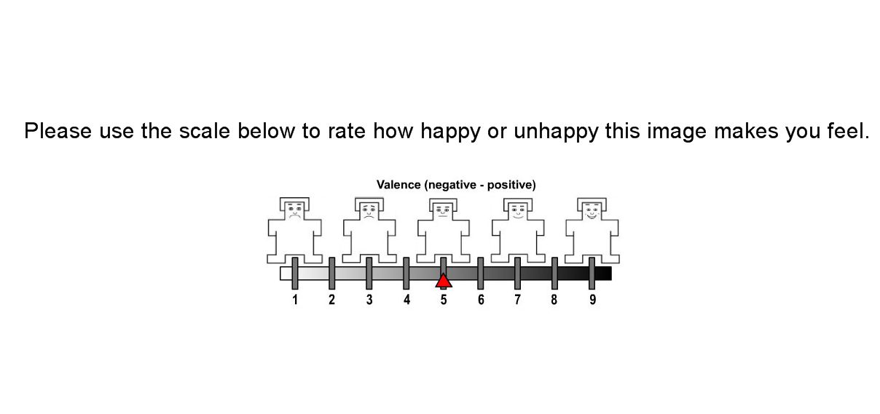
When you see this, press a number from 1 to 9 to indicate how happy or unhappy the image you just saw made you feel.
LEFT
RIGHT
PRESS THE RIGHT KEY TO CONTINUE

Slide 51
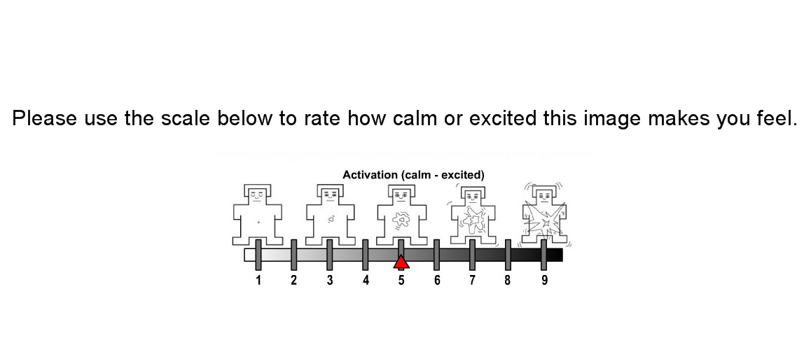
When you see this, press a number from 1 to 9 to indicate how calm or excited the image you just saw made you feel.
LEFT
RIGHT
PRESS THE RIGHT KEY TO CONTINUE

Slide 52
Press the RIGHT key when you are ready to begin.
LEFT
RIGHT
PRESS THE RIGHT KEY TO CONTINUE
Notes:
Outside the scanner

Slide 53
Baseline
RIGHT
PRESS THE RIGHT KEY TO CONTINUE

Slide 54
For this task, please keep your eyes on the
computer monitor. You will see various images and
may hear sounds through your headphones.
For this task, we will be taking a 5-minute reading
while you watch pictures of flowers on the screen.
Please stay still during the entire task.
LEFT
RIGHT
PRESS THE RIGHT KEY TO CONTINUE
Notes:
Changed the wording a bit so it will make sense regardless of when it is administered (e.g., before all tasks or in between some).

Slide 55
Press the RIGHT key when you are ready to begin.
LEFT
RIGHT
PRESS THE RIGHT KEY TO CONTINUE
Notes:
Outside the scanner

Slide 56
DRIVING
RIGHT
PRESS THE RIGHT KEY TO CONTINUE

Slide 57
Task 1: Move and Go
In this part, you are going to
perform 20 trials of a short task.
Please read and follow the instructions
carefully before starting.
If you have any questions or comments
concerning the experiment, please do not
hesitate to ask the experimenter.
LEFT
RIGHT
PRESS THE RIGHT KEY TO CONTINUE
Notes:
Changed the wording a bit so it will make sense regardless of when it is administered (e.g., before all tasks or in between some).

Slide 58
Task 1: Move and Go
In this part, you are going to
perform a number trials of a short task.
Please read and follow the instructions
carefully before starting.
If you have any questions or comments
concerning the experiment, please do not
hesitate to ask the experimenter.
LEFT
RIGHT
PRESS THE RIGHT KEY TO CONTINUE
Notes:
Changed the wording a bit so it will make sense regardless of when it is administered (e.g., before all tasks or in between some).

Slide 59
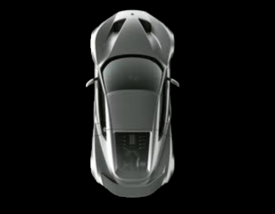
In each trial, you will see a car appear at the
bottom of the screen (like shown below).
In each trial, you will control a vehicle using a joystick.
Your task is to push the joystick all the way forward as quickly as you can once you see the car start moving.
LEFT
RIGHT
PRESS THE RIGHT KEY TO CONTINUE
Notes:
Could we replace the pic of the car, with a pic of the car AND the dot that indicates the position of the joystick.

Slide 60
Note: You will see a dot on the screen to indicate
the position of the joystick. If you move before
the car starts, then the current trial will be aborted.
There is a 2 second count-down
at the beginning of each trial.
And there will be a crisp beep to
indicate the end of each trial.
LEFT
RIGHT
PRESS THE RIGHT KEY TO CONTINUE
Notes:
Could we replace the pic of the car, with a pic of the car AND the dot that indicates the position of the joystick.

Slide 61
Note: If you move before
the car starts, then the current trial will be aborted.
There is a 2 second count-down
at the beginning of each trial.
There will be a crisp beep to
indicate the end of each trial and you
must hold the joy stick forward
until you hear the beep.
LEFT
RIGHT
PRESS THE RIGHT KEY TO CONTINUE
Notes:
Could we replace the pic of the car, with a pic of the car AND the dot that indicates the position of the joystick.

Slide 62
Press the RIGHT key when you are ready to begin.
LEFT
RIGHT
PRESS THE RIGHT KEY TO CONTINUE
Notes:
Outside the scanner

Slide 63
Task 2: Speed and Stop
Please read and follow the instructions
carefully before starting.
If you have any questions or comments
concerning the experiment, please do not
hesitate to ask the experimenter.
LEFT
RIGHT
PRESS THE RIGHT KEY TO CONTINUE

Slide 64
There are 30 trials in this experiment,
divided into different blocks.
In each trial, you will control a vehicle using a joystick.
You can control the speed of the vehicle by
pushing the joystick forward or pulling it backward.
LEFT
RIGHT
PRESS THE RIGHT KEY TO CONTINUE
Notes:
Replace the car screenshot with whatever is most relevant for this part of the task.

Slide 65
Each trial starts with a 2 second count-down.
You have 10 seconds to complete each trial.
A timing bar will appear on the screen to indicate
the time left. And it will turn green once the
car is getting close to the stop sign.
LEFT
RIGHT
PRESS THE RIGHT KEY TO CONTINUE
Notes:
Replace the car screenshot with whatever is most relevant for this part of the task.

Slide 66
Your task is to drive the vehicle as quickly as possible and stop at the stop sign within 10 seconds.
Demonstration of those conditions will be shown shortly.
LEFT
RIGHT
PRESS THE RIGHT KEY TO CONTINUE
Notes:
Replace the car screenshot with whatever is most relevant for this part of the task.

Slide 67
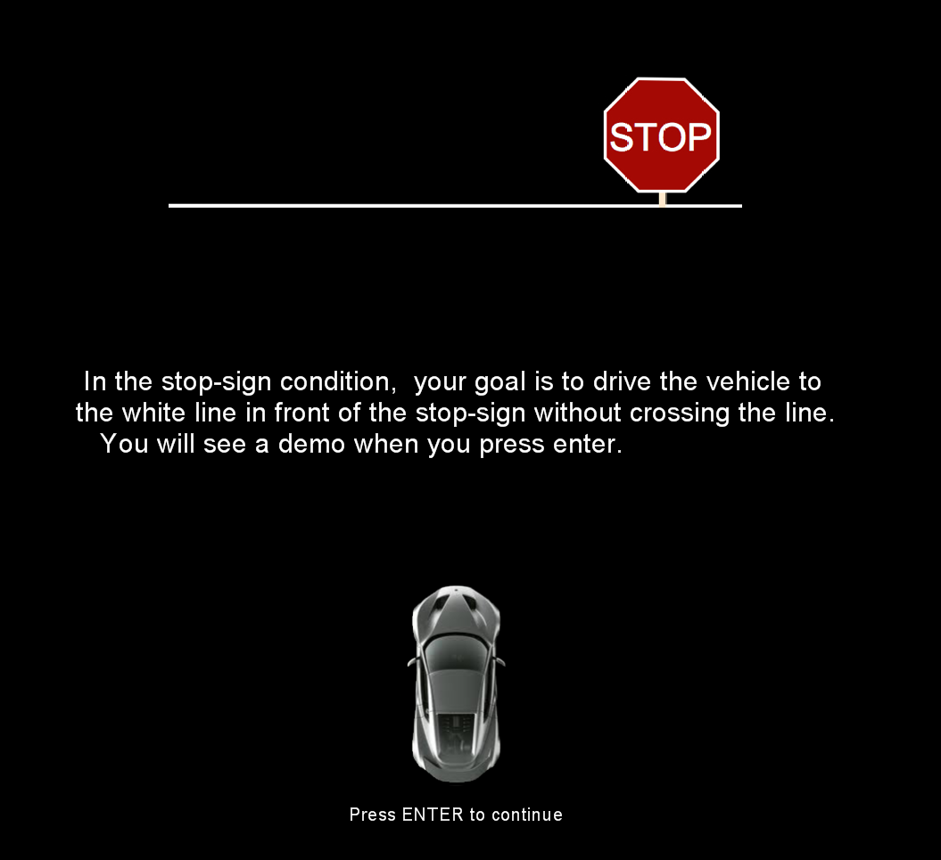
In the stop-sign condition, your goal is to drive the vehicle to the white line in front of the stop-sign without crossing the line. You will see a demo when you press the RIGHT key.
LEFT
RIGHT
PRESS THE RIGHT KEY TO CONTINUE

Slide 68
Now please try to drive the car to the white line before the stop-sign. You have 20 seconds to practice.
Note that you will need to keep a small amount of pressure on the joy stick to keep the car stopped at the line.
Practice will begin when you press the RIGHT key.
LEFT
RIGHT
PRESS THE RIGHT KEY TO CONTINUE

Slide 69
NOTE:
The timing bar will turn green when the car is getting close to the stop-sign, but…
The goal is still to drive as quickly as possible and stop it as close as possible to the stop sign.
LEFT
RIGHT
PRESS THE RIGHT KEY TO CONTINUE

Slide 70
Please let the experimenter know if you are
unclear of the task or how to control the joystick.
Note: There are 2 blocks with breaks in between.
LEFT
RIGHT
PRESS THE RIGHT KEY TO CONTINUE

Slide 71
Press the RIGHT key when you are ready to begin.
LEFT
RIGHT
PRESS THE RIGHT KEY TO CONTINUE
Notes:
Outside the scanner

Slide 72
FACES AND BORDERS
RIGHT
PRESS THE RIGHT KEY TO CONTINUE
Notes:
Do we need to label this differently for the subject’s purpose?

Slide 73
In this task, you will see a series of pictures
with different colored borders.
For each picture, your task is to
PULL the joystick if the border is YELLOW or
PUSH the joystick if the border is BLUE.
Begin each trial by pressing the trigger button on the joystick while holding the joystick in the central position.
When the picture appears, respond according to the previous instructions: PULL the joystick if the border is YELLOW and PUSH the joystick if the border is BLUE.
LEFT
RIGHT
PRESS THE RIGHT KEY TO CONTINUE
Notes:
I would add screens with screenshots – but I think Charlie and others may not want this so as to reduce their exposure to pictures prior to the task (to reduce habitatuion, etc.)

Slide 74
In this task, you will see a series of pictures
with different colored borders.
For each picture, your task is to
PULL the joystick if the border is BLUE or
PUSH the joystick if the border is YELLOW.
Begin each trial by pressing the trigger button on the joystick while holding the joystick in the central position.
When the picture appears, respond according to the previous instructions: PULL the joystick if the border is BLUE and PUSH the joystick if the border is YELLOW.
LEFT
RIGHT
PRESS THE RIGHT KEY TO CONTINUE
Notes:
I would add screens with screenshots – but I think Charlie and others may not want this so as to reduce their exposure to pictures prior to the task (to reduce habitatuion, etc.)

Slide 75
After you PUSH or PULL in response to the picture,
bring the joystick back to the central position and start the next trial by pressing the trigger button.
Make sure to move the joystick completely towards you
or completely away from you.
Also remember to make sure the joystick
is in the center to begin each trial.
Please work as quickly and accurately as you can.
Do you have any questions?
LEFT
RIGHT
PRESS THE RIGHT KEY TO CONTINUE

Slide 76
Remember, PULL the joystick if the border is YELLOW and
PUSH the joystick if the border is BLUE.
LEFT
RIGHT
PRESS THE RIGHT KEY TO CONTINUE

Slide 77
Remember, PULL the joystick if the border is BLUE and
PUSH the joystick if the border is YELLOW.
LEFT
RIGHT
PRESS THE RIGHT KEY TO CONTINUE

Slide 78
Press the RIGHT key when you are ready to begin.
LEFT
RIGHT
PRESS THE RIGHT KEY TO CONTINUE
Notes:
Outside the scanner

Slide 79
Runway Task
RIGHT
PRESS THE RIGHT KEY TO CONTINUE
Notes:
Do we need to label this differently for the subject’s purpose?

Slide 80
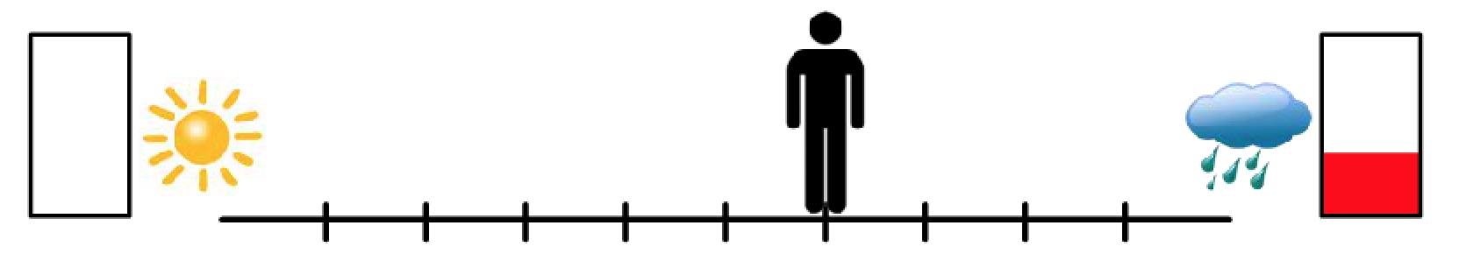
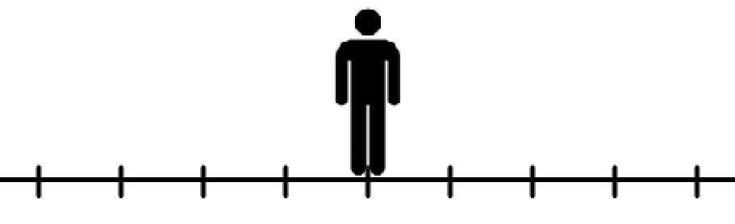
For this next task, you will see a runway on the screen,
just like that shown below.
There will be two potential outcomes, represented with
pictures on each side of the runway.
LEFT
RIGHT
PRESS THE RIGHT KEY TO CONTINUE

Slide 81
The rectangle represents amount of reward points
to be given for that outcome.
If there is no red in the rectangle, that equals 0 points.
The more red, the more points are given for that outcome.
For this task – points are just points, however.
You will not receive any money based on your performance on this task.
If the outcome associated
with this side occurred,
you would get 0 points
If the outcome associated
with this side occurred,
you would get some points
LEFT
RIGHT
PRESS THE RIGHT KEY TO CONTINUE
Notes:
On these – Teresa would just read the top part. But then leave the slide up for several seconds after she is done reading to give them time to study the image.

Slide 82
The sun and clouds represent the type of image
you will be shown for that outcome.
If there is a sun, you would see a positive picture and sound
before you are given the reward points.
If there is a cloud, you will be shown a negative picture and sound before you are given reward points.
If the outcome associated with this side occurred, you would see a positive picture but would get no points.
If the outcome associated
with this side occurred, you would see a negative picture but would get some points
LEFT
RIGHT
PRESS THE RIGHT KEY TO CONTINUE

Slide 83
For each trial, you are to move the figure on the screen,
using 3 buttons – the left arrow button, the right arrow button, and the down arrow button.
The left arrow button moves the figure to the left,
the right arrow button moves the figure to the right,
and the down arrow button locks in your answer.
LEFT
RIGHT
PRESS THE RIGHT KEY TO CONTINUE

Slide 84
You will move the figure to indicate how much
you want each of the two possible outcomes.
For example, if you think you might want the outcome
on the right just a little more than the outcome on the left, than you may move your figure one or two positions
to the right of the center mark – like shown now.
LEFT
Notes:
Automatically move to the next slide when finished with the text.

Slide 85
You will move the figure to indicate how much
you want each of the two possible outcomes.
For example, if you think you might want the outcome
on the right just a little more than the outcome on the left, than you may move your figure one or two positions
to the right of the center mark – like shown now.
LEFT
Notes:
Automatically move to the next slide when finished with the text.

Slide 86
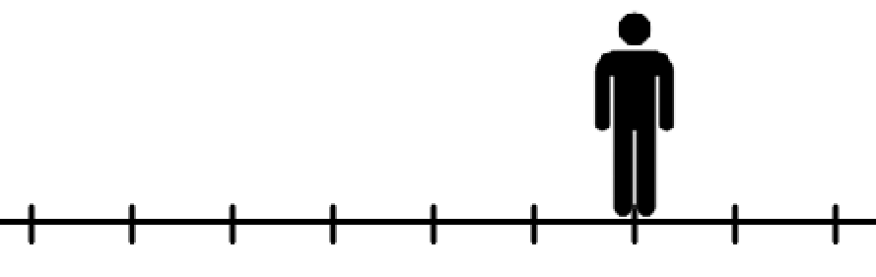
You will move the figure to indicate how much
you want each of the two possible outcomes.
For example, if you think you might want the outcome
on the right just a little more than the outcome on the left, than you may move your figure one or two positions
to the right of the center mark – like shown now.
LEFT
RIGHT
PRESS THE RIGHT KEY TO CONTINUE

Slide 87
If you absolutely want the left outcome much more
than the right outcome, you may move the figure
all the way to the left – like shown now.
LEFT
Notes:
Automatically move on to the next slide

Slide 88
If you absolutely want the left outcome much more
than the right outcome, you may move the figure
all the way to the left – like shown now.
LEFT
Notes:
Automatically move on to the next slide

Slide 89
If you absolutely want the left outcome much more
than the right outcome, you may move the figure
all the way to the left – like shown now.
LEFT
Notes:
Automatically move on to the next slide

Slide 90
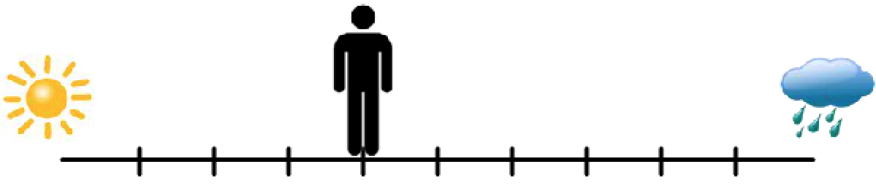
If you absolutely want the left outcome much more
than the right outcome, you may move the figure
all the way to the left – like shown now.
LEFT
Notes:
Automatically move on to the next slide

Slide 91
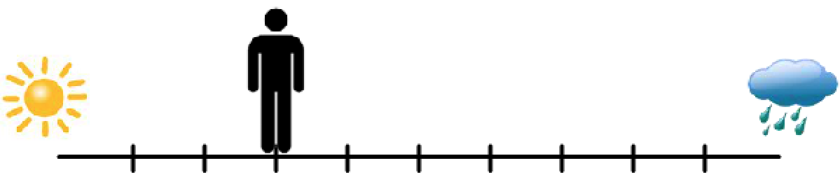
If you absolutely want the left outcome much more
than the right outcome, you may move the figure
all the way to the left – like shown now.
LEFT
Notes:
Automatically move on to the next slide

Slide 92
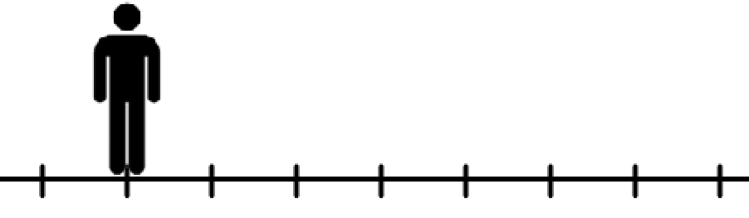
If you absolutely want the left outcome much more
than the right outcome, you may move the figure
all the way to the left – like shown now.
LEFT
Notes:
Automatically move on to the next slide

Slide 93
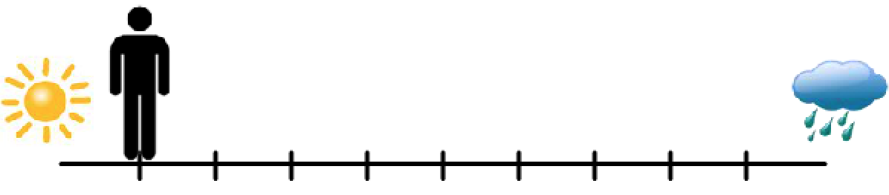
If you absolutely want the left outcome much more
than the right outcome, you may move the figure
all the way to the left – like shown now.
LEFT
RIGHT
PRESS THE RIGHT KEY TO CONTINUE
Notes:
Automatically move on to the next slide

Slide 94
If you are completely unsure which one you want to
happen more, you may place the figure in the very middle, like shown now.
LEFT
Notes:
Automatically move on to the next slide

Slide 95
If you are completely unsure which one you want to
happen more, you may place the figure in the very middle, like shown now.
LEFT
Notes:
Automatically move on to the next slide

Slide 96
If you are completely unsure which one you want to
happen more, you may place the figure in the very middle, like shown now.
LEFT
Notes:
Automatically move on to the next slide

Slide 97
If you are completely unsure which one you want to
happen more, you may place the figure in the very middle, like shown now.
LEFT
Notes:
Automatically move on to the next slide

Slide 98
If you are completely unsure which one you want to
happen more, you may place the figure in the very middle, like shown now.
LEFT
RIGHT
PRESS THE RIGHT KEY TO CONTINUE

Slide 99
The closer you are to one side, the more likely that outcome will be to happen; and likewise, the further away you are from one side, the less likely that outcome will be to happen.
So, for example, if you moved all the way to one side (like shown), you would have a 90% chance of the nearest outcome occurring; but still a 10% chance of the other outcome occurring.
90% chance that this outcome would occur
10% chance that this outcome would occur
LEFT
RIGHT
PRESS THE RIGHT KEY TO CONTINUE

Slide 100
You will have 4 seconds to move the
figure to the location you want it.
Be prepared that the figure may start out in different positions;
it may sometimes start in the middle of the runway,
while at other times, it may start all the way to one side.
No matter what, you still only have 4 seconds
to move the figure to the where you want it in.
LEFT
RIGHT
PRESS THE RIGHT KEY TO CONTINUE

Slide 101
As soon as you have the figure where you want,
lock in your answer using the down arrow button. However, realize
that once you lock in your answer you can no longer move the figure.
If you have not locked in your answer within 4 seconds,
the location of the figure at the end of the 4 seconds
will be taken as your final answer.
An example of what it looks like when you
lock in your answer will be shown now.
LEFT
Notes:
Automatically proceed to next slide.

Slide 102
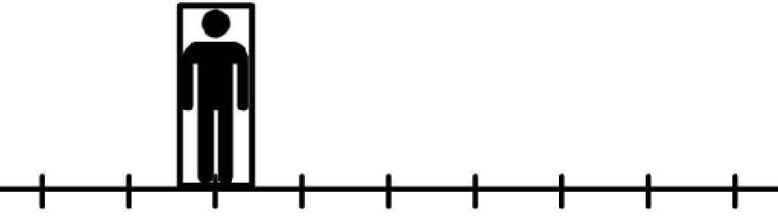
As soon as you have the figure where you want,
lock in your answer using the down arrow button. However, realize
that once you lock in your answer you can no longer move the figure.
If you have not locked in your answer within 4 seconds,
the location of the figure at the end of the 4 seconds
will be taken as your final answer.
An example of what it looks like when you
lock in your answer will be shown now.
LEFT
RIGHT
PRESS THE RIGHT KEY TO CONTINUE

Slide 103
Again, for each trial we want you to place the figure in a way
that indicates how much you want each of the 2 outcomes.
At the end of the task, you will see how many points
you won in relation to others who have performed this task.
It is completely up to you what decision you make on
each trial. So, on each trial, you should consider whether
you want the points that are offered or whether you would
rather view a positive picture. It is completely up to you.
LEFT
RIGHT
PRESS THE RIGHT KEY TO CONTINUE

Slide 104
I will now show you an example of each type of picture,
positive and negative; as well as an example of how it
will look when you are given the reward points.
Next is an example of what you would see for the left outcome of this trial, which includes a positive picture and 0 reward points.
Press the RIGHT key to see this example.
LEFT
RIGHT
PRESS THE RIGHT KEY TO CONTINUE

Slide 105

Notes:
sounds/IADSPA/812_Choir.mp3

Slide 106

Notes:
Play the smallreward.mp3 sound

Slide 107
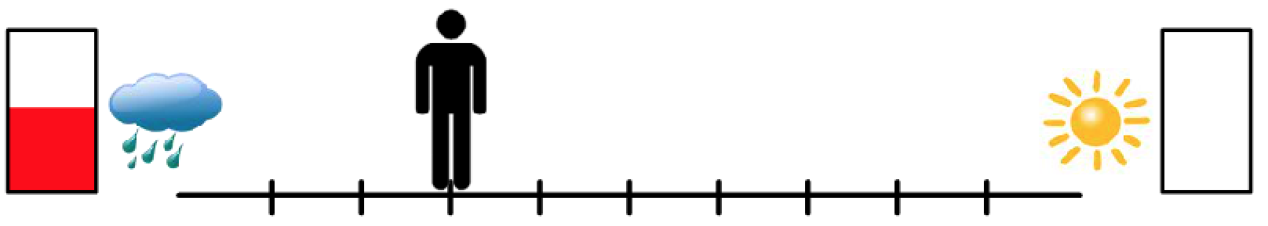
Now I will show you what would happen if the left outcome
of this trial (shown below) occurred, which includes a
negative picture and reward points.
Please be warned that the negative pictures and sounds are very negative and may include such things as blood, combat, and dead bodies. You have no way of knowing HOW bad the picture will be for each trial…you will just know that is going to be negative.
During the task, you will have some control over how likely and how often you see the negative pictures, but we want to give you an example here so that you will know what to expect.
Press the RIGHT key to see this example.
LEFT
RIGHT
PRESS THE RIGHT KEY TO CONTINUE
Notes:
Have backspace go back to before the example images were shown.

Slide 108
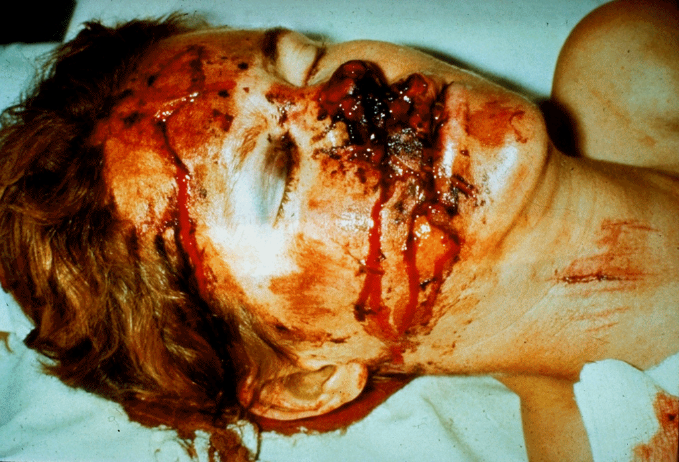
Notes:
sounds/IADSNA/698_RagingFire.mp3

Slide 109
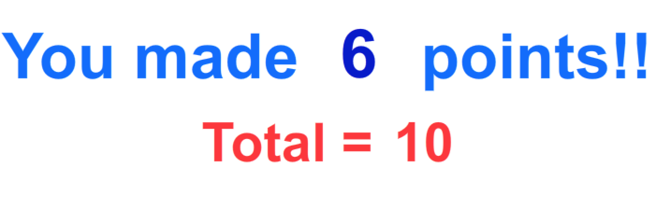
Notes:
Play the bigreward.mp3 sound

Slide 110
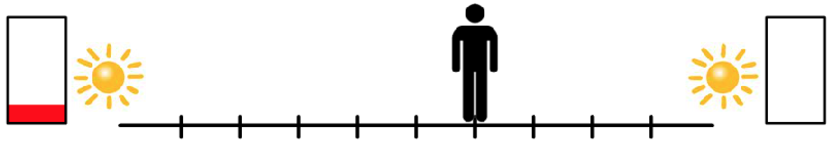
Note that some of the trials may look like that shown below, where there is no risk of seeing a negative picture and both choices are associated with a positive picture.
In these instances, there really is no reason
not to go towards the points.
These types of trials make sure you are
paying attention the entire task.
LEFT
RIGHT
PRESS THE RIGHT KEY TO CONTINUE
Notes:
Have backspace go back to before the example images were shown.

Slide 111
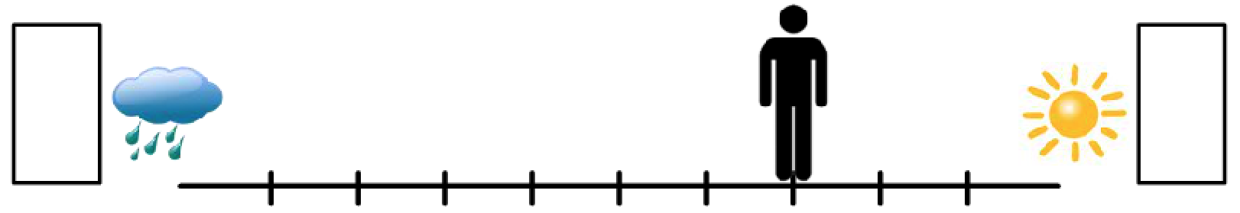
Note that some of the trials may look like this, where there are no reward points offered for either outcome.
In these instances, there is no reason not to go towards the sun unless you are really wanting to see the negative picture.
LEFT
RIGHT
PRESS THE RIGHT KEY TO CONTINUE

Slide 112
On the next screen, you will be shown an example of
what you will see at the end of the task, telling you how
many points you got in relation to others on the task.
You will be shown either an honorable mention, third place, second place, or first place ribbon based on the points you earned.
Press the RIGHT key to see this example.
LEFT
RIGHT
PRESS THE RIGHT KEY TO CONTINUE

Slide 113
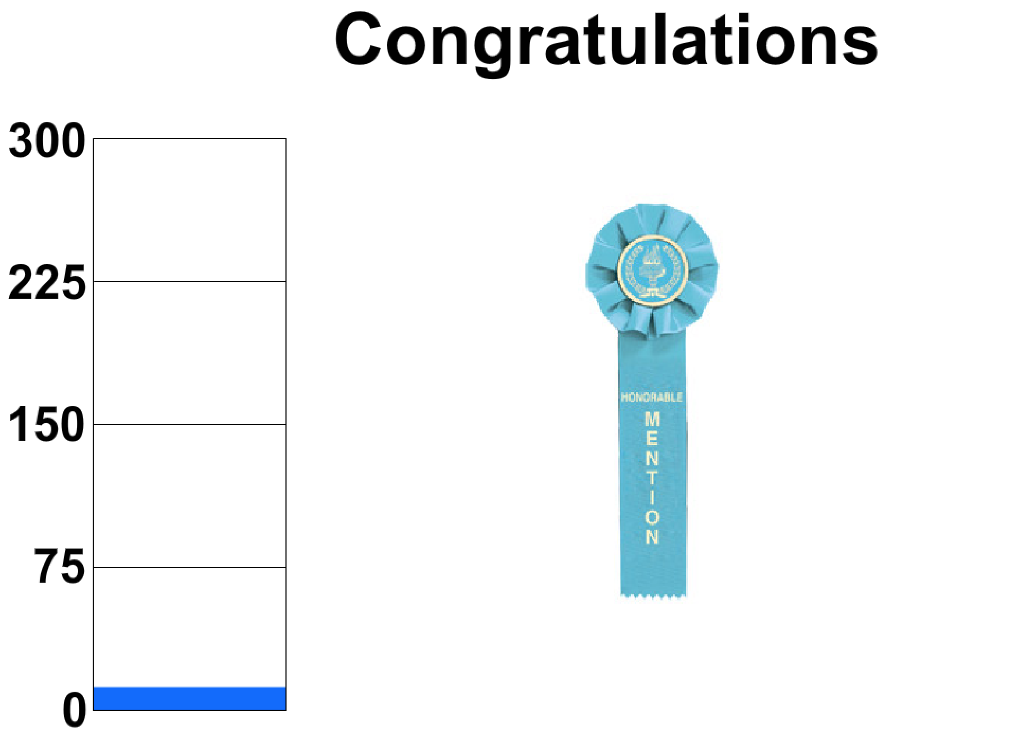
Place holder for screenshot
LEFT
RIGHT
PRESS THE RIGHT KEY TO CONTINUE
Notes:
Play the sound “lastscreen.wav”
Automatically move on

Slide 114
Remember, for each trial, we want you to be indicating how strongly you want each possible outcome, given the potential reward points as well as the potential images and sounds you would have to see in order to get those points.
Note that between each trial will be a cross “+”. The amount of time this “+” is on the screen will vary throughout the task.
Please let the administrator know now if
you have any questions on this task.
Now we will try a few example trials,
just so you can practice.
LEFT
RIGHT
PRESS THE RIGHT KEY TO CONTINUE

Slide 115
Press the RIGHT key when you are ready to begin.
LEFT
RIGHT
PRESS THE RIGHT KEY TO CONTINUE
Notes:
Outside the scanner

Slide 116
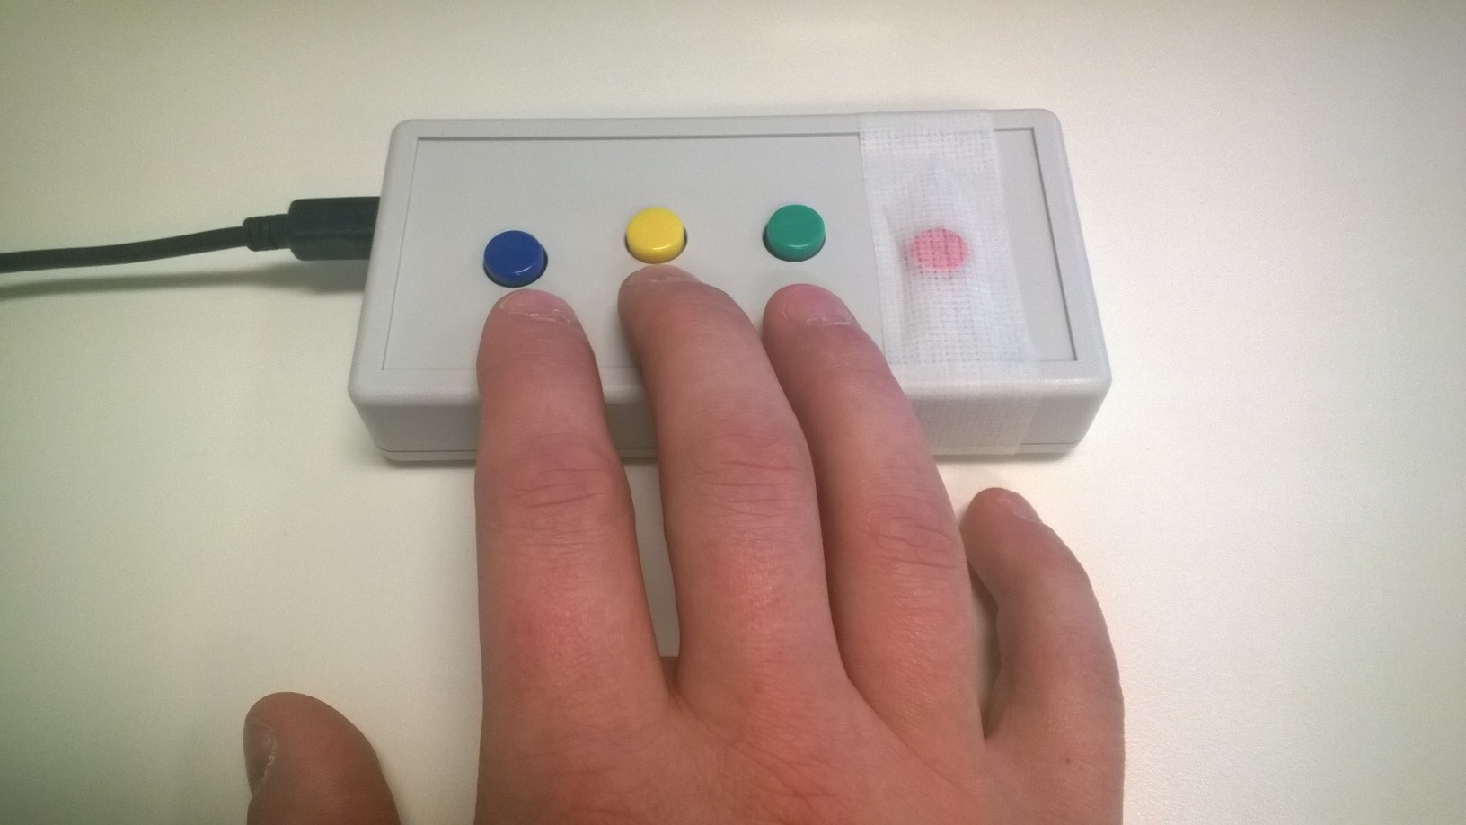
You will be using a button box like the one shown to make responses while you are in the scanner. Place your hand so that you can use your index and middle fingers to press the right and left buttons. Your ring finger will be used at times to select responses.
Please tell the experimenter if you have any questions about how to use the button box.
Left
Right
Select
RIGHT
PRESS THE RIGHT BUTTON TO CONTINUE

Slide 117
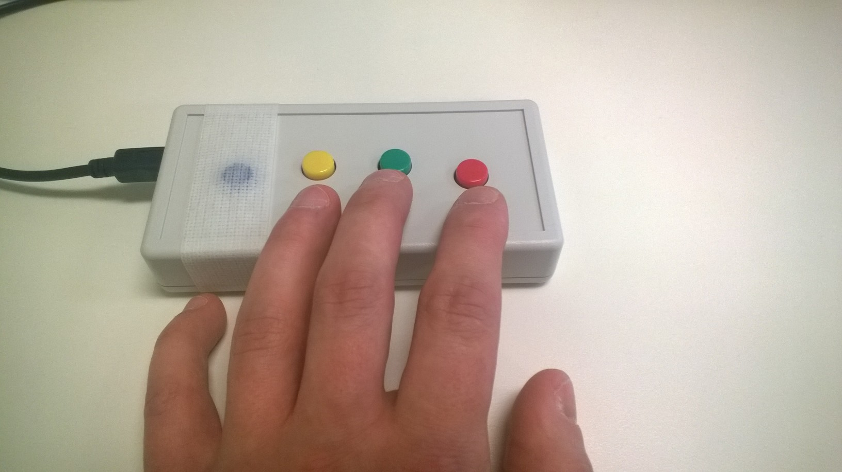
You will be using a button box like the one shown to make responses while you are in the scanner. Place your hand so that you can use your index and middle fingers to press the right and left buttons. Your ring finger will be used at times to select responses.
Please tell the experimenter if you have any questions about how to use the button box.
Left
Select
Right
RIGHT
PRESS THE RIGHT BUTTON TO CONTINUE

Slide 118
Arrows and Pictures
RIGHT
PRESS THE RIGHT BUTTON TO CONTINUE
Notes:
Outside the scanner

Slide 119


For this task you will see arrows on the screen pointing either to the left or to the right. Your job is to push the button that corresponds to the arrow on the screen.
LEFT
RIGHT
PRESS THE RIGHT BUTTON TO CONTINUE

Slide 120
For this task you will see arrows on the screen pointing either to the left or to the right. Your job is to push the button that corresponds to the arrow on the screen.
LEFT
RIGHT
PRESS THE RIGHT BUTTON TO CONTINUE

Slide 121
At various points during this task, you may see an image on the screen. You do not need to respond to the image, just look at it and be ready for the next set of arrows.
At times during the task, you may also hear a loud scream through the headphones. You do not need to do anything in response to this noise.
LEFT
RIGHT
PRESS THE RIGHT BUTTON TO CONTINUE

Slide 122
Part of what we are interested in with this task is attention. So, even though it is a long task, we want you to do your best to pay attention and push the button for the direction the arrow is pointing as quickly and accurately as possible.
Please let us know if you have any questions.
LEFT
RIGHT
PRESS THE RIGHT BUTTON TO CONTINUE

Slide 123
Now you will complete a practice session.
This session will not have any noises.
LEFT
RIGHT
PRESS THE RIGHT BUTTON TO CONTINUE

Slide 124
We will ask you to make a few ratings at the end of each run in the scanner.
Remember, use your index and middle finger to move the selector and use your ring finger to make your selection.
Left
Right
Select
RIGHT
PRESS THE RIGHT BUTTON TO CONTINUE

Slide 125
We will ask you to make a few ratings at the end of each run in the scanner.
Remember, use your index and middle finger to move the selector and use your ring finger to make your selection.
Left
Select
Right
RIGHT
PRESS THE RIGHT BUTTON TO CONTINUE

Slide 126
Press the RIGHT button when you are ready to begin
LEFT
RIGHT
PRESS THE RIGHT BUTTON TO CONTINUE
Notes:
Inside the scanner

Slide 127
Arrows and Pictures
PRESS THE RIGHT BUTTON TO CONTINUE
Notes:
Inside the scanner

Slide 128
Remember, your job is to quickly press the button with your index or middle finger that corresponds to the arrows that appear on the screen.
PRESS THE RIGHT BUTTON TO CONTINUE

Slide 129
Remember, your job is to quickly press the button with your index or middle finger that corresponds to the arrows that appear on the screen.
PRESS THE RIGHT BUTTON TO CONTINUE

Slide 130
At times you may see a picture or hear a loud scream; you do not need to respond to these pictures or sounds.
Part of what we are interested in with this task is attention. So, even though it is a long task, we want you to do your best to pay attention and push the button for the direction the arrow is pointing as quickly and accurately as possible.
PRESS THE RIGHT BUTTON TO CONTINUE

Slide 131
Now you will have a chance to hear the scream that will play during the session.
When you are ready, press the RIGHT button and you will hear the scream.
PRESS THE RIGHT BUTTON TO CONTINUE

Slide 132
[LOUDNESS RATING]
PRESS z TO MOVE ON

Slide 133
Press the RIGHT button when you are ready to begin
PRESS THE RIGHT BUTTON TO CONTINUE
Notes:
Inside the scanner

Slide 134
Arrows and Pictures
PRESS THE RIGHT BUTTON TO CONTINUE
Notes:
Inside the scanner

Slide 135
Now you will complete another run of the Arrows and Pictures task.
PRESS THE RIGHT BUTTON TO CONTINUE

Slide 136
Press the RIGHT button when you are ready to begin
PRESS THE RIGHT BUTTON TO CONTINUE
Notes:
Inside the scanner

Slide 137
Focused Attention
RIGHT
PRESS THE RIGHT BUTTON TO CONTINUE
Notes:
Inside the scanner

Slide 138
This task will have three types of trials:
heart attention, stomach attention, and target attention.
Each trial lasts 10 seconds.
LEFT
RIGHT
PRESS THE RIGHT BUTTON TO CONTINUE

Slide 139
When you see “HEART”: focus your attention on the sensation of your heart in your chest.
When you see “STOMACH”: focus your attention on the sensation of your stomach.
During these trials, do not focus your attention on a different part of the body.
LEFT
RIGHT
PRESS THE RIGHT BUTTON TO CONTINUE

Slide 140
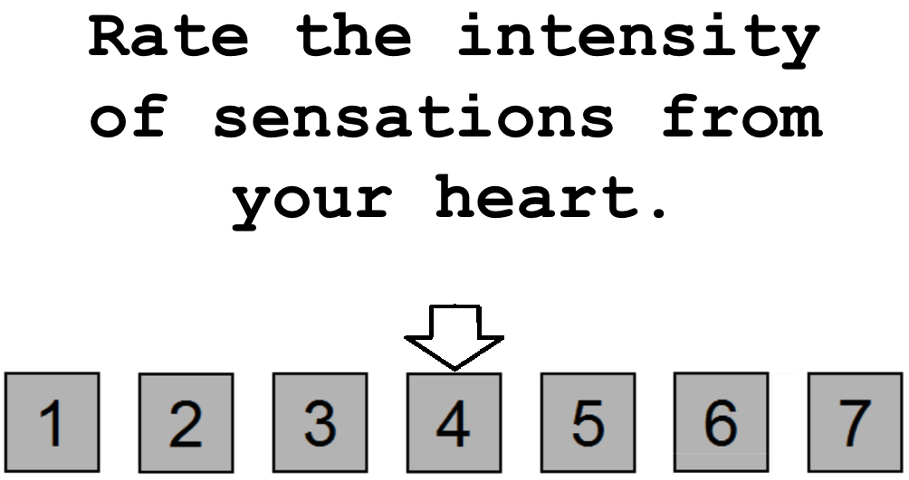
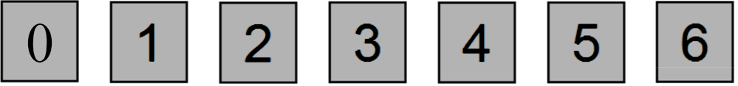
Occasionally, you will be asked to rate on a scale of 0 to 6 your experience. For example, you might see the word “HEART” for 10 seconds, during which time you would focus your attention on the sensations of your heart in your chest. Afterward, you might see the screen shown below
LEFT
RIGHT
PRESS THE RIGHT BUTTON TO CONTINUE
Notes:
NOTE: change rating scale from (1 to 7) to (0 to 6)

Slide 141
You would then use a button box to indicate your rating on the 0-to-6 scale; 0 = no sensation, 3 = moderate sensation, and 6 = extreme sensation.
Use your index and middle fingers to move the arrow, and your ring finger to make a selection.
LEFT
RIGHT
PRESS THE RIGHT BUTTON TO CONTINUE
Notes:
NOTE: also change rating scale from (1 to 7) to (0 to 6)

Slide 142
Note that you might be very aware of your heartbeat when it beats quickly, or even slowly. If you were extremely aware of your heartbeat, you might provide a rating of 6. In contrast, if you experienced no sensation from your heart during the preceding 10 seconds, you might provide a rating of 0.
You will have 5 seconds to make your response. If you fail to respond in the 5 seconds, don’t worry about it. Just get ready for the next trial.
LEFT
RIGHT
PRESS THE RIGHT BUTTON TO CONTINUE
Notes:
NOTE: also change rating scale from (1 to 7) to (0 to 6)

Slide 143
Similarly, if you were extremely aware that your stomach was very full, you might provide a rating of 6. Alternatively, if you were extremely aware that your stomach was empty, you might also provide a rating of 6. In contrast, if you experienced no sensation from your stomach during the preceding 10 seconds, you might provide a rating of 0.
LEFT
RIGHT
PRESS THE RIGHT BUTTON TO CONTINUE
Notes:
CHANGE RATE INSTRUCTION BOX: “Rate your awareness of sensations from your heart.” NOTE: also change rating scale from (1 to 7) to (0 to 6)

Slide 144
During the target detection trials, you will see the word “TARGET” appear in the middle of the screen. At fixed intervals, the color of the word “TARGET” will briefly change to a lighter shade of gray. Your job will be to focus your attention on these color changes and notice how intensely the color changes over the ten-second interval. In short, notice how much brighter the word becomes during these color changes. After approximately half of the target detection trials you will make a rating on a scale of 0 to 6 to indicate the intensity of the color change you saw. You will have 5 seconds to make your response. If you fail to respond in the 5 seconds, don’t worry about it. Just get ready for the next trial.
LEFT
RIGHT
PRESS THE RIGHT BUTTON TO CONTINUE

Slide 145

Here is an example of what a target detection trial may look like.
LEFT
Notes:
Add screenshot.

Slide 146

Here is an example of what a target detection trial may look like.
LEFT
Notes:
Add screenshot.

Slide 147
Here is an example of what a target detection trial may look like.
LEFT
Notes:
Add screenshot.

Slide 148
Here is an example of what a target detection trial may look like.
LEFT
RIGHT
PRESS THE RIGHT BUTTON TO CONTINUE
Notes:
Add screenshot.

Slide 149
The time between trials will be variable. Between trials you will see a “+” in the center of the screen. Whenever you see the “+” simply do your best to clear your mind and prepare for the next trial.
LEFT
RIGHT
PRESS THE RIGHT BUTTON TO CONTINUE

Slide 150
Now you will complete a practice run of the Focused Attention Task.
LEFT
RIGHT
PRESS THE RIGHT BUTTON TO CONTINUE

Slide 151
Press the RIGHT button when you are ready to begin
LEFT
RIGHT
PRESS THE RIGHT BUTTON TO CONTINUE
Notes:
Inside the scanner

Slide 152
Focused Attention
PRESS THE RIGHT BUTTON TO CONTINUE
Notes:
Inside the scanner

Slide 153
Now you will complete the Focused Attention Task.
Remember, when you see the words HEART or STOMACH, focus your attention on sensations coming from that part of your body.
When you see the word TARGET, focus your attention on how intensely it changes colors
PRESS THE RIGHT BUTTON TO CONTINUE

Slide 154
When you are asked to make a rating, use your index, middle, and ring fingers to rate the intensity of the sensations you felt or the intensity of the color change.
Left
Right
Select
PRESS THE RIGHT BUTTON TO CONTINUE

Slide 155
When you are asked to make a rating, use your index, middle, and ring fingers to rate the intensity of the sensations you felt or the intensity of the color change.
Select
Left
Right
PRESS THE RIGHT BUTTON TO CONTINUE

Slide 156
Press the RIGHT button when you are ready to begin
PRESS THE RIGHT BUTTON TO CONTINUE
Notes:
Inside the scanner

Slide 157
Focused Attention
PRESS THE RIGHT BUTTON TO CONTINUE
Notes:
Inside the scanner

Slide 158
Now you will complete another run of the Focused Attention task.
PRESS THE RIGHT BUTTON TO CONTINUE

Slide 159
Press the RIGHT button when you are ready to begin
PRESS THE RIGHT BUTTON TO CONTINUE
Notes:
Inside the scanner

Slide 160
Money
RIGHT
PRESS THE RIGHT BUTTON TO CONTINUE
Notes:
Outside the scanner

Slide 161





In this experiment, you will respond
as quickly as possible to earn money.
You will see a cue indicating how much money you
can win or avoid losing. After this cue, a triangle will appear.
To win, hit any button as fast as you can
when the triangle appears.
CUE
TARGET, PRESS ANY BUTTON
WAIT
Time
[RESULT SHOWN]
LEFT
RIGHT
PRESS THE RIGHT BUTTON TO CONTINUE
Notes:
Add screenshots of the two screens (cue and triangle) below the text – to show a timeline of the task.
And what button(s)? Maybe indicate in parentheses?

Slide 162
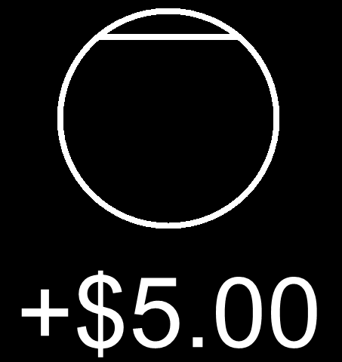
Cues are either circles or squares.
CIRCLE cues mean that you can
EARN that amount if you hit the target.
An example of a CIRCLE cue is shown below.
LEFT
RIGHT
PRESS THE RIGHT BUTTON TO CONTINUE
Notes:
Add screenshot.

Slide 163
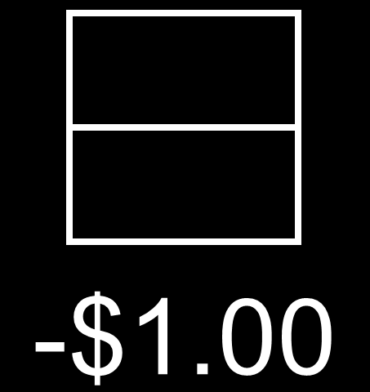
SQUARE cues mean that you can
AVOID LOSING that amount if you hit the target.
An example of a SQUARE cue is shown below.
LEFT
RIGHT
PRESS THE RIGHT BUTTON TO CONTINUE
Notes:
Add screenshot.

Slide 164
If you miss a CIRCLE cue, you will
NOT GAIN the amount in the cue.
If you miss a SQUARE cue, you will
LOSE the amount in the cue.
LEFT
RIGHT
PRESS THE RIGHT BUTTON TO CONTINUE
Notes:
Add screenshot.

Slide 165
Now you will complete a practice run. You will not win money based on this practice session, but you will be paid based on the amount you win inside the scanner.
LEFT
RIGHT
PRESS THE RIGHT BUTTON TO CONTINUE
Notes:
Add screenshot.

Slide 166
Press the RIGHT button when you are ready to begin
LEFT
RIGHT
PRESS THE RIGHT BUTTON TO CONTINUE
Notes:
Inside the scanner

Slide 167
Money
PRESS THE RIGHT BUTTON TO CONTINUE
Notes:
Inside the scanner

Slide 168
Now you will complete the Money task.
You will see a cue indicating how much money you
can win or avoid losing. After this cue, a triangle will appear.
To win, hit any button as fast as you can
when the triangle appears.
CUE
TARGET, PRESS ANY BUTTON
WAIT
Time
[RESULT SHOWN]
PRESS THE RIGHT BUTTON TO CONTINUE
Notes:
Add screenshots of the two screens (cue and triangle) below the text – to show a timeline of the task.
And what button(s)? Maybe indicate in parentheses?

Slide 169
Remember, you will be paid based on how well you do on this task, so try your best to hit a button whenever the white triangle appears.
PRESS THE RIGHT BUTTON TO CONTINUE
Notes:
Add screenshot.

Slide 170
Press the RIGHT button when you are ready to begin
PRESS THE RIGHT BUTTON TO CONTINUE
Notes:
Inside the scanner

Slide 171
Money
PRESS THE RIGHT BUTTON TO CONTINUE
Notes:
Inside the scanner

Slide 172
Now you will complete another run of the Money task.
PRESS THE RIGHT BUTTON TO CONTINUE

Slide 173
Press the RIGHT button when you are ready to begin
PRESS THE RIGHT BUTTON TO CONTINUE
Notes:
Inside the scanner

Slide 174
Stop Signal
RIGHT
PRESS THE RIGHT BUTTON TO CONTINUE
Notes:
Outside the scanner

Slide 175


For this task, you will see “X”s and “O”s on the screen.
Press the LEFT button if you see “X” and
the RIGHT button if you see “O”.
An example of what the different screens
will look like for this task is shown below.
press LEFT
press RIGHT
Time
LEFT
RIGHT
PRESS THE RIGHT BUTTON TO CONTINUE
Notes:
Add screenshots of an X and an O screen – like a timeline of screenshots.

Slide 176
For this task, you will see “X”s and “O”s on the screen.
Press the LEFT button if you see “X” and
the RIGHT button if you see “O”.
An example of what the different screens
will look like for this task is shown below.
press LEFT
press RIGHT
Time
LEFT
RIGHT
PRESS THE RIGHT BUTTON TO CONTINUE
Notes:
Add screenshots of an X and an O screen – like a timeline of screenshots.

Slide 177
There will be 4 sections of this task.
In the FIRST section, just respond to the “X” or “O”.
In the SECOND section, you will hear a tone. Just ignore it.
In both the THIRD and FOURTH sections, respond as usual to the “X”s and “O”s except when you hear a tone.
DON’T press any button if you hear the tone.
You will see instructions to remind you
at the beginning of each section.
LEFT
RIGHT
PRESS THE RIGHT BUTTON TO CONTINUE

Slide 178
Press the RIGHT button when you are ready to begin
LEFT
RIGHT
PRESS THE RIGHT BUTTON TO CONTINUE
Notes:
Inside the scanner

Slide 179
Stop Signal
PRESS THE RIGHT BUTTON TO CONTINUE
Notes:
Inside the scanner

Slide 180
Now you will complete the Stop Signal Task.
For this task, you will see “X”s and “O”s on the screen.
Press the LEFT button if you see “X” and
the RIGHT button if you see “O”.
PRESS THE RIGHT BUTTON TO CONTINUE
Notes:
For inside the scanner.
What happens when they press enter?

Slide 181
Now you will complete the Stop Signal Task.
For this task, you will see “X”s and “O”s on the screen.
Press the LEFT button if you see “X” and
the RIGHT button if you see “O”.
PRESS THE RIGHT BUTTON TO CONTINUE
Notes:
For inside the scanner.
What happens when they press enter?

Slide 182
There are 6 sections and you will occasionally hear a tone. DON’T press any button when you hear the tone.
You will see instructions to remind you
at the beginning of each section.
PRESS THE RIGHT BUTTON TO CONTINUE
Notes:
For inside the scanner.
What happens when they press enter?

Slide 183
Press the RIGHT button when you are ready to begin
PRESS THE RIGHT BUTTON TO CONTINUE
Notes:
Inside the scanner

Slide 184
Rest
PRESS THE RIGHT BUTTON TO CONTINUE
Notes:
Inside the scanner

Slide 185
For this scan, you will see a “+” in the center of the screen.
Focus on the “+”, clear your mind and try not to think of anything in particular.
PRESS THE RIGHT BUTTON TO CONTINUE
Notes:
For inside the scanner.
What happens when they press enter?

Slide 186
Press the RIGHT button when you are ready to begin
PRESS THE RIGHT BUTTON TO CONTINUE
Notes:
Inside the scanner

Slide 187
Finger Tapping
RIGHT

Slide 188
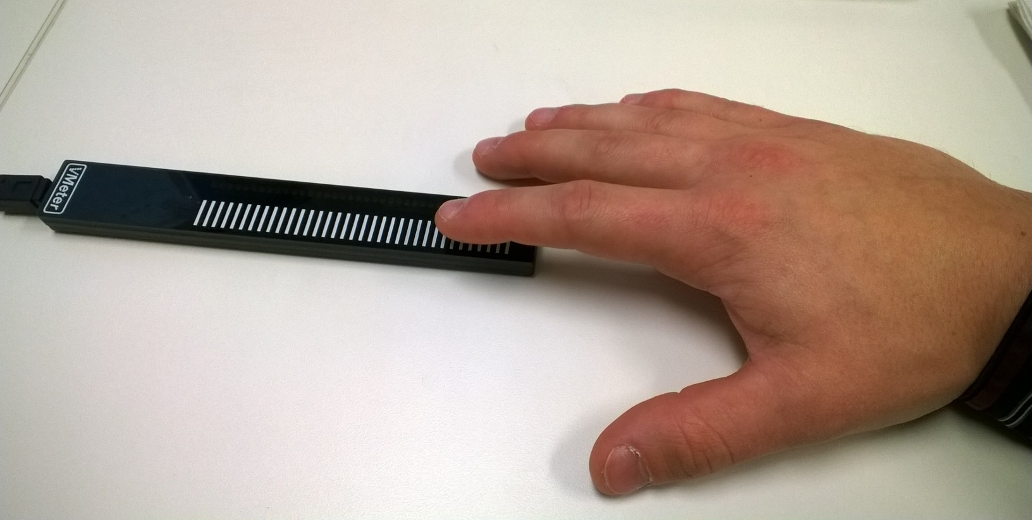
For this test, I will have you use your index finger to tap on this device as quickly as possible while keeping the rest of your hand still.
There will be several trials with each hand, and each trial will begin when you start tapping.
Please place your dominant hand as shown and practice tapping the device for a few seconds.
[After a brief practice, press RIGHT to move on to the first trial]
LEFT
RIGHT

Slide 189
Tap the device to begin

Slide 190
For this trail, use your DOMINANT hand.
When you’re ready, press the RIGHT key and then you will tap the device to begin.
RIGHT

Slide 191
For this trail, use your DOMINANT hand.
When you’re ready, press the RIGHT key and then you will tap the device to begin.
This trial will be somewhat long.
Do your best to keep tapping as fast as you can until the screen says STOP.
RIGHT

Slide 192
For this trail, use your NON-DOMINANT hand.
When you’re ready, press the RIGHT key and then you will tap the device to begin.
This trial will be somewhat long.
Do your best to keep tapping as fast as you can until the screen says STOP.
RIGHT

Slide 193
For this trail, use your NON-DOMINANT hand.
When you’re ready, press the RIGHT key and then you will tap the device to begin.
RIGHT

Slide 194
STOP
[press RIGHT to continue]
RIGHT

Slide 195
KEEP TAPPING

Slide 196
Heartbeat
RIGHT
PRESS THE RIGHT KEY TO CONTINUE

Slide 197
[This task should be done using speakers instead of head phones. Experimenter: make the appropriate adjustments]
LEFT
RIGHT

Slide 198
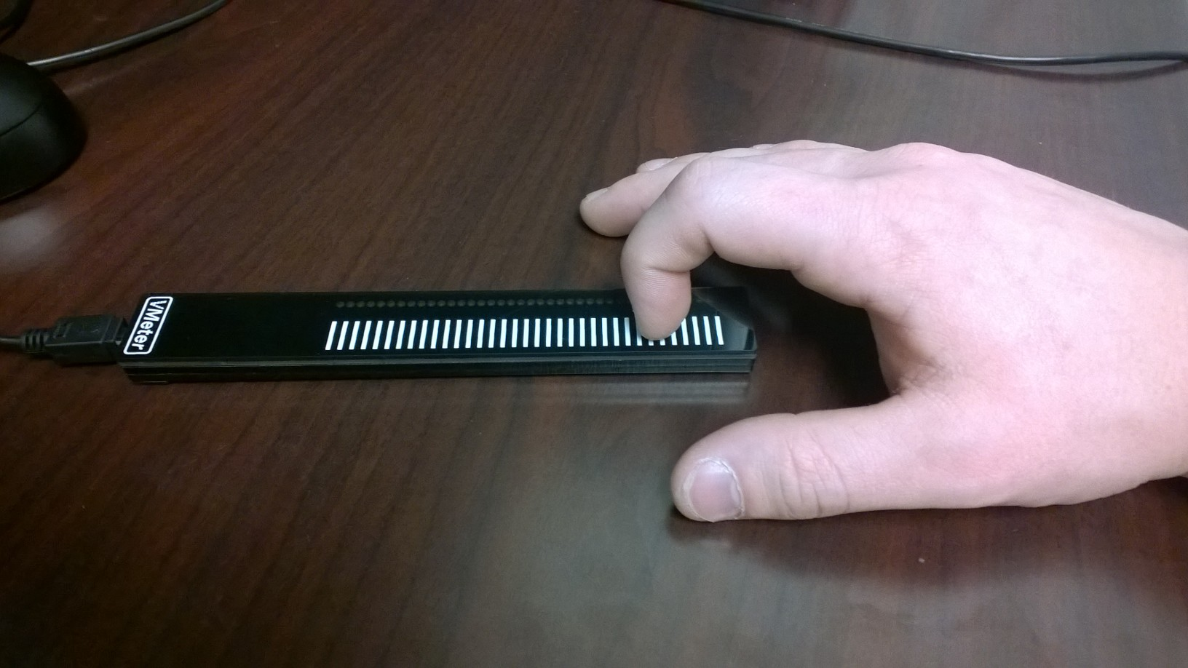
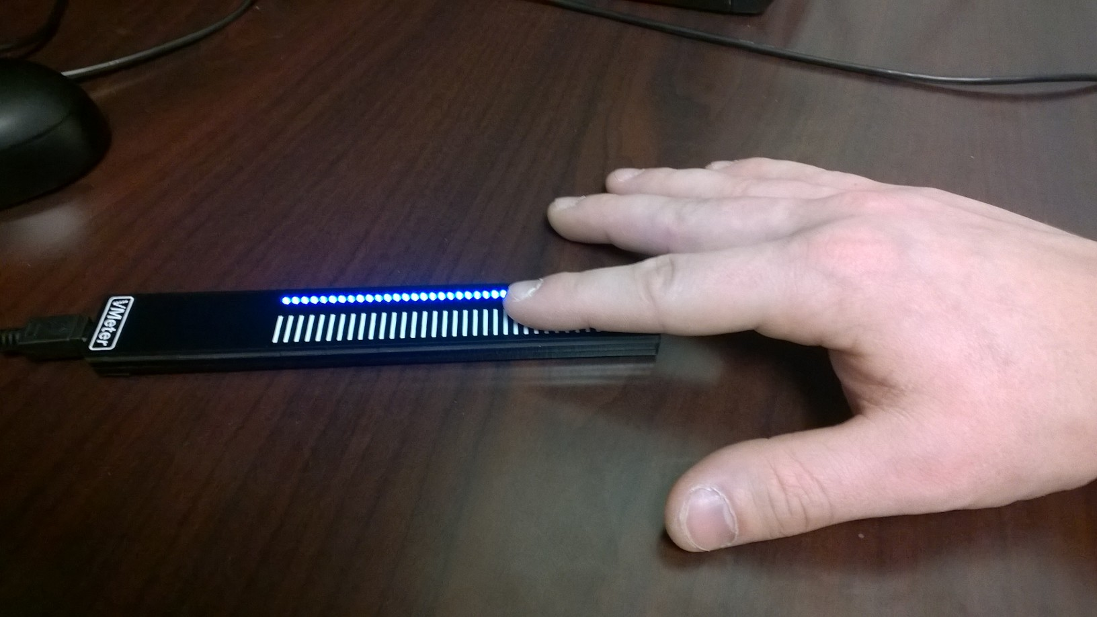
For this test, I will have you use your index finger to tap on this device with your eyes closed. There will be several trials with specific instructions--you may for example tap in sync with your heartbeat or with a presented tone.
Please place your dominant hand as shown and practice tapping the device.
Be sure to tap with the flat part of your finger--not your finger tip/nail--and tap on the white lines.
[After a brief practice, press RIGHT to move on to the first trial]
RIGHT

Slide 199
For this test, I will have you use your index finger to press the down key with your eyes closed. There will be several trials with specific instructions--you may for example press in sync with your heartbeat or with a presented tone.
LEFT
RIGHT

Slide 200
This trial will begin with a spoken countdown.
First you will need to close your eyes and then press down to begin.
You will begin pressing when the voice says ‘GO’ and stop when it says ‘STOP’
RIGHT
PRESS THE RIGHT KEY TO CONTINUE

Slide 201
With your eyes closed, please press down in synchrony with your heartbeat. Try to mirror your heartbeat as closely as possible. Even if you are not sure, take your best guess.
When you understand the instructions and are ready to begin, press the right key. You will then press down to begin.
LEFT
RIGHT
PRESS THE RIGHT KEY TO CONTINUE

Slide 202
Press down to begin

Slide 203
Please keep your
eyes closed

Slide 204
This trial will begin with a spoken countdown.
First you will need to close your eyes and then press down to begin.
You will begin pressing when the voice says ‘GO’ and stop when it says ‘STOP’
RIGHT
PRESS THE RIGHT KEY TO CONTINUE

Slide 205
This trial will begin with a spoken countdown.
First you will need to close your eyes and then tap the device to begin the trial.
You will begin tapping when the voice says ‘GO’ and stop when it says ‘STOP’
RIGHT
PRESS THE RIGHT KEY TO CONTINUE

Slide 206
You will hear a series of tones played through the speakers.
With your eyes closed, please press down in synchrony with the tones.
Try to mirror the tones as closely as possible by pressing every time you hear a tone.
When you understand the instructions and are ready to begin, press the right key. You will then press down to begin.
LEFT
RIGHT
PRESS THE RIGHT KEY TO CONTINUE

Slide 207
Tap the device to begin

Slide 208
Please keep your
eyes closed

Slide 209
This trial will begin with a spoken countdown.
First you will need to close your eyes and then press down to begin.
You will begin pressing when the voice says ‘GO’ and stop when it says ‘STOP’
RIGHT
PRESS THE RIGHT KEY TO CONTINUE

Slide 210
Sometimes it can be difficult to feel your heartbeat. Some people may even go the whole trial without tapping at all.
For this trial, only press down when you actually feel your heartbeat.
If you do not feel your heartbeat, then you should NOT press down.
When you understand the instructions and are ready to begin, press the right key. You will then press down to begin.
LEFT
RIGHT
PRESS THE RIGHT KEY TO CONTINUE

Slide 211
Press down to begin

Slide 212
Please keep your
eyes closed

Slide 213
Tap the device to begin

Slide 214
Sometimes it can be difficult to feel your heartbeat. Some people may even go the whole trial without pressing at all.
For this trial, only press down when you actually feel your heartbeat.
If you do not feel your heartbeat, then you should NOT press down.
RIGHT
PRESS THE RIGHT KEY TO CONTINUE

Slide 215
This time, however, we would like you to empty your lungs of all air, and then take as deep of a breath as possible and hold it for as long as you can tolerate.
While you’re holding your breath, press down when you feel your heartbeat.
Please try your best and only press during the moments when you actually feel your heartbeat.
This trial will last one minute. Continue to press with your heartbeat even if you have to start breathing again.
LEFT
RIGHT
PRESS THE RIGHT KEY TO CONTINUE

Slide 216
You will close your eyes, empty your lungs of all air, take as deep of a breath as possible, and then press down as soon as you stop inhaling to begin the trial.
Please press only during the moments when you actually feel your heartbeat.
When you understand the instructions,
press the RIGHT key.
LEFT
RIGHT
PRESS THE RIGHT KEY TO CONTINUE

Slide 217
Once you have finished inhaling,
press down to begin.
Go ahead.

Slide 218
Breath Hold
RIGHT
PRESS THE RIGHT KEY TO CONTINUE

Slide 219
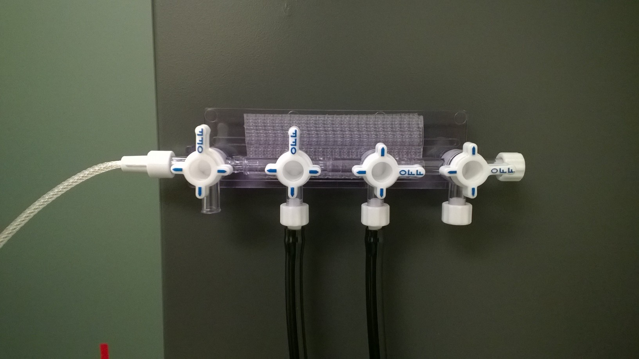
[Experimenter: attach the gas sample line to the manifold]
PRESS z TO MOVE ON

Slide 220
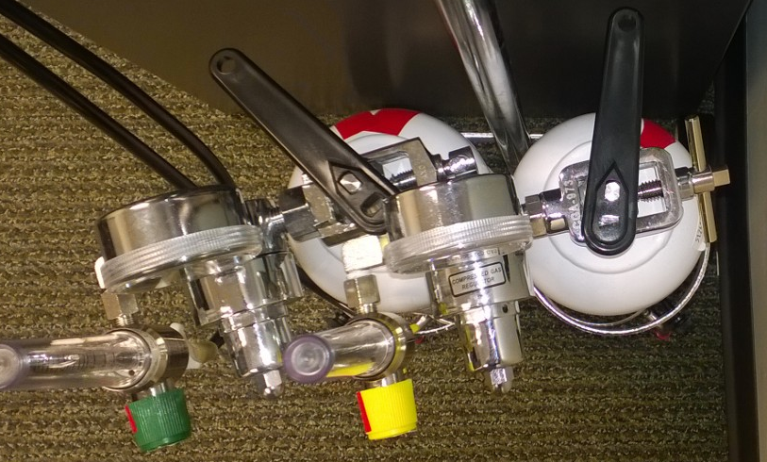
[Experimenter: open both main tank valves, using the red tape as a guide]
PRESS z TO MOVE ON

Slide 221
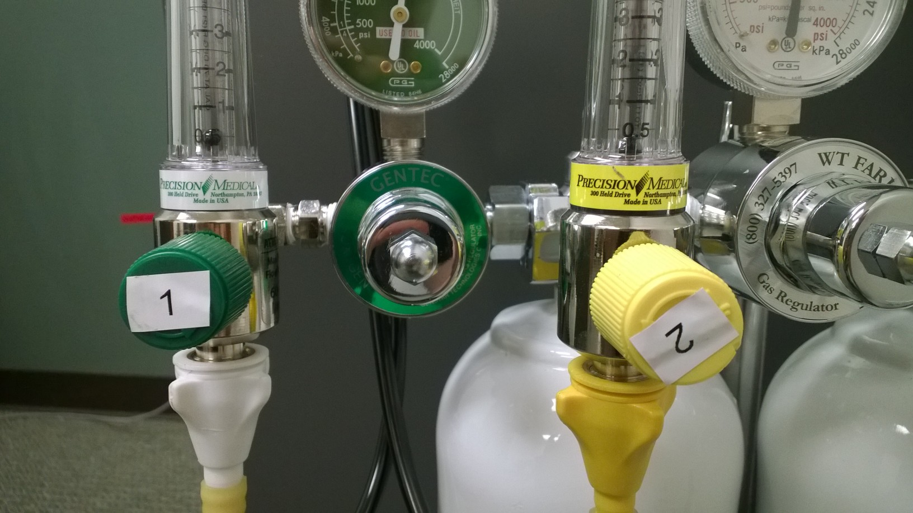
Barely Floating
[Experimenter: Turn the green knob until the “1” is upright. The ball in the meter should just barely start to float.]
PRESS z TO MOVE ON

Slide 222
[Experimenter: Wait for this slide to advance on its own: 20 seconds.]

Slide 223
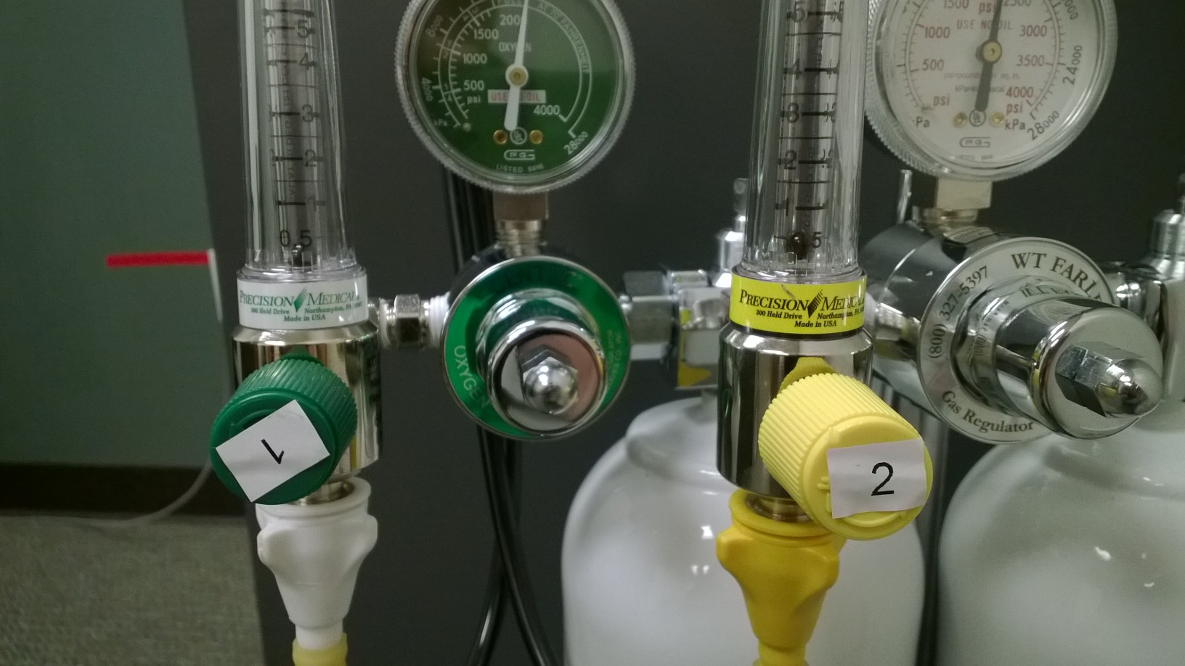
Barely Floating
[Experimenter: Turn the green knob all the way right. Turn the yellow knob left until the “2” is upright. The ball in the meter should just barely start to float.]
PRESS z TO MOVE ON

Slide 224
[Experimenter: Wait for this slide to advance on its own: 20 seconds.]

Slide 225
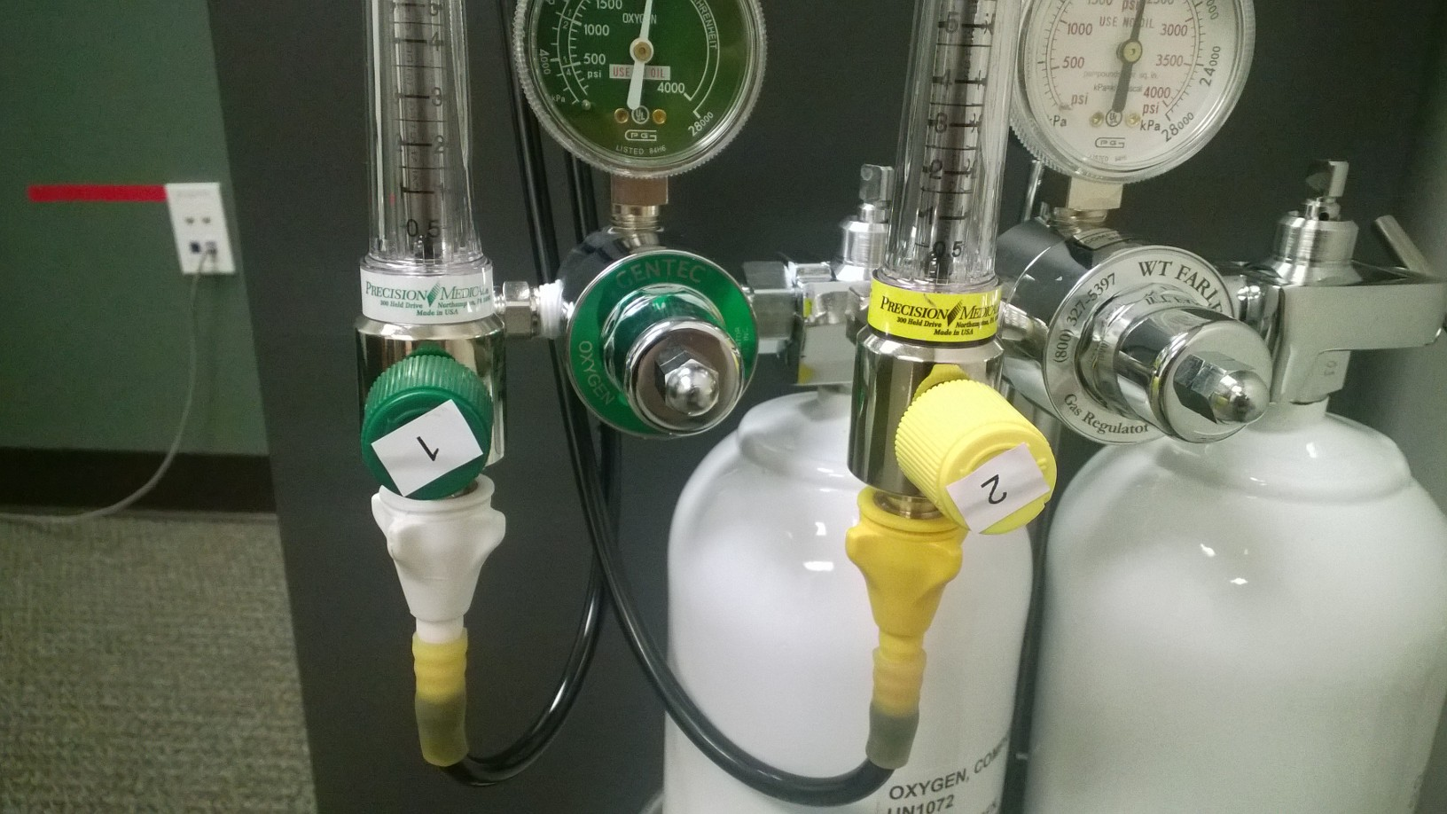
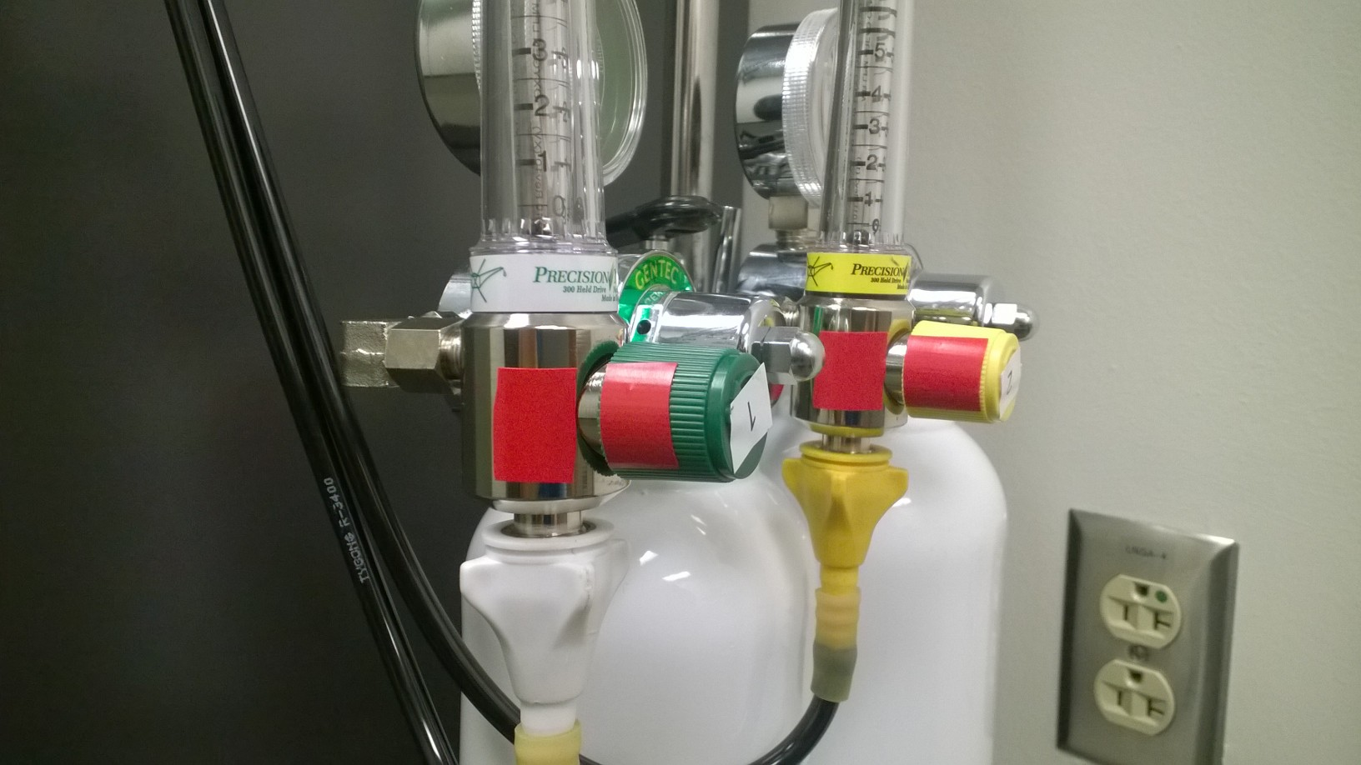
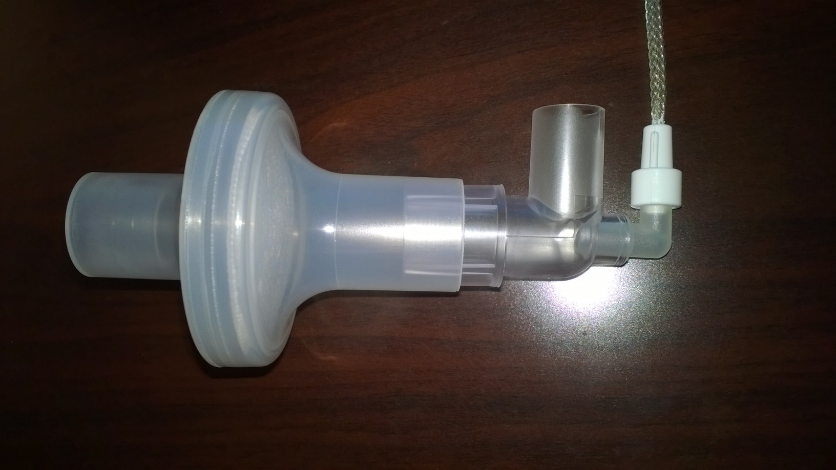
[Experimenter: Turn the yellow knob all the way right. Remove the gas sample line from the manifold and assemble the breathing apparatus.]
PRESS z TO MOVE ON

Slide 226
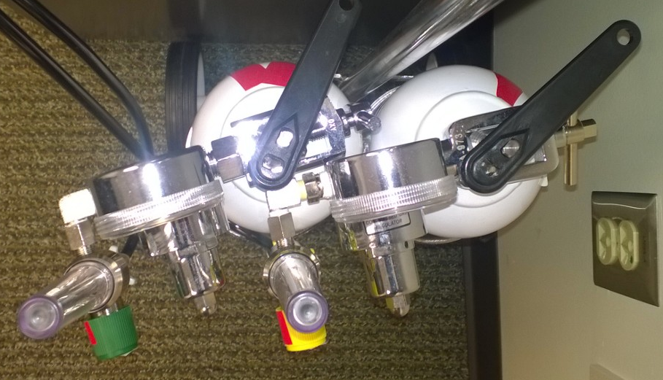
[Experimenter: close both main tank valves, using the red tape as a guide]
PRESS z TO MOVE ON

Slide 227
[Experimenter: attach the ear clip now]
PRESS z TO MOVE ON

Slide 228
Now we will take some baseline breath recordings.
You will take a few normal breaths through this tube. Try to make a good seal with your mouth so that air doesn’t escape around the tube.
Please press the RIGHT key when you are ready to begin, then take five normal breaths through the tube.
Mouth
Here
RIGHT
PRESS THE RIGHT KEY TO CONTINUE

Slide 229
Take five normal breaths through the tube
[Press ENTER when done]

Slide 230
For this trial, you will hold your breath with your eyes closed while wearing the nose clip.
First, you will close your eyes. Next, you will empty your lungs of all air, and then take as deep of a breath as possible and hold it for as long as you can tolerate.
It’s really important that you hold your breath
for as long as you can.
There is a maximum time limit, and if you reach this limit you will be instructed to stop and breathe.
RIGHT
PRESS THE RIGHT KEY TO CONTINUE

Slide 231
When you are ready, close your eyes, empty your lungs of all air, take as deep a breath as you can, and press the RIGHT key as soon as you stop inhaling. When you can not hold your breath any longer, or you reach the maximum limit, blow into the tube and continue to breathe through the tube for five breaths.

Slide 232
KEEP YOUR EYES CLOSED
[When you exhale, breathe through the tube five times]

Slide 233
BREAK
Please take a moment to catch your breath. This slide is on a timer and will advance on its own.

Slide 234
Ice Bath
RIGHT
PRESS THE RIGHT KEY TO CONTINUE

Slide 235
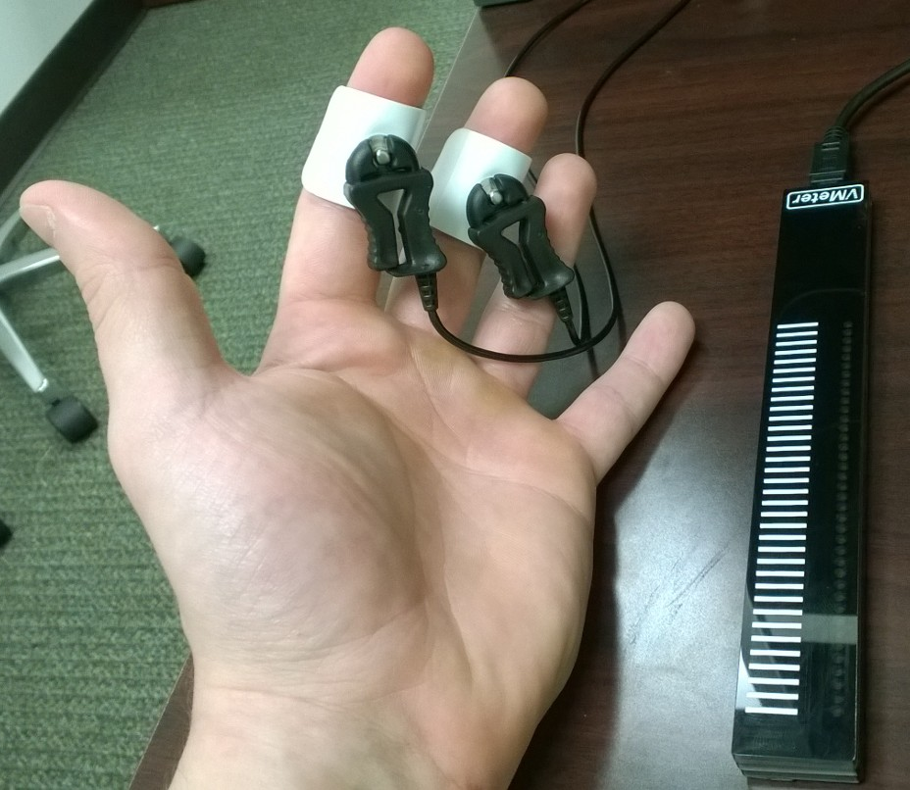
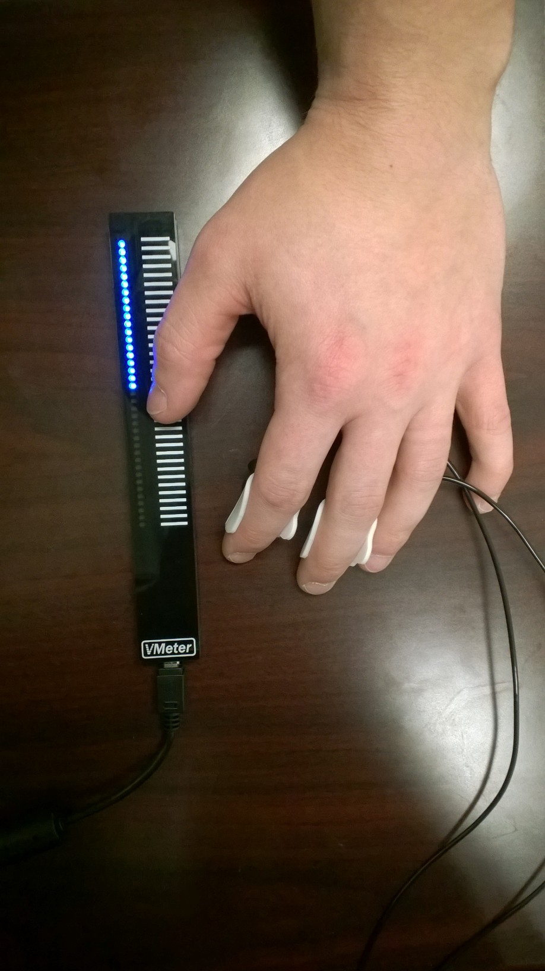
For this test, you will place your dominant hand in a pool of cold water and hold it there as long as you can tolerate.
It’s really important that you keep your hand in the water
for as long as you can.
While your hand is in the water, you will use the device shown to rate the intensity of the pain you are experiencing.
Your rating will be shown by the lights on the device and also on the screen.
[press RIGHT to practice rating]
RIGHT

Slide 236

The trial will begin with a three second countdown. Please place your hand in the water up to the wrist as shown when the voice says go and don’t forget to rate the pain intensity with your other hand.
Try to face the screen and look at your rating during the task.
There is a maximum time limit, and if you reach this limit you will be instructed to stop.
The water will be cold. Please keep your hand in for as long as you can tolerate and do not make a fist in the water.
[Experimenter: attach the temperature probe and leave the room]
[Participant: press RIGHT to begin the countdown]

Slide 237
Press the RIGHT button when you are ready to begin
This is run 1 of 10
PRESS THE RIGHT BUTTON TO CONTINUE
Notes:
Inside the scanner

Slide 238
Press the RIGHT button when you are ready to begin
This is run 2 of 10
PRESS THE RIGHT BUTTON TO CONTINUE
Notes:
Inside the scanner

Slide 239
Press the RIGHT button when you are ready to begin
This is run 3 of 10
PRESS THE RIGHT BUTTON TO CONTINUE
Notes:
Inside the scanner

Slide 240
Press the RIGHT button when you are ready to begin
This is run 4 of 10
PRESS THE RIGHT BUTTON TO CONTINUE
Notes:
Inside the scanner

Slide 241
Press the RIGHT button when you are ready to begin
This is run 5 of 10
PRESS THE RIGHT BUTTON TO CONTINUE
Notes:
Inside the scanner

Slide 242
Press the RIGHT button when you are ready to begin
This is run 6 of 10
PRESS THE RIGHT BUTTON TO CONTINUE
Notes:
Inside the scanner

Slide 243
Press the RIGHT button when you are ready to begin
This is run 7 of 10
PRESS THE RIGHT BUTTON TO CONTINUE
Notes:
Inside the scanner

Slide 244
Press the RIGHT button when you are ready to begin
This is run 8 of 10
PRESS THE RIGHT BUTTON TO CONTINUE
Notes:
Inside the scanner

Slide 245
Press the RIGHT button when you are ready to begin
This is run 9 of 10
PRESS THE RIGHT BUTTON TO CONTINUE
Notes:
Inside the scanner

Slide 246
Press the RIGHT button when you are ready to begin
This is run 10 of 10
PRESS THE RIGHT BUTTON TO CONTINUE
Notes:
Inside the scanner

Slide 247

Remember, please try not to rest your chin on your hand. Press the RIGHT key when you are ready to begin.
LEFT
RIGHT
PRESS THE RIGHT KEY TO CONTINUE
Notes:
Outside the scanner

Slide 248

Remember, please try not to rest your chin on your hand and please do not chew gum during the experiment. Press the RIGHT key when you are ready to begin.
LEFT
RIGHT
PRESS THE RIGHT KEY TO CONTINUE
Notes:
Outside the scanner

Slide 249
Shapes and Faces
PRESS THE RIGHT BUTTON TO CONTINUE
Notes:
Inside the scanner

Slide 250
In this task, you will see sets of three images arranged in a triangle and your job is to decide which of the bottom two images matches the top one. Press the left or right button to make your selection as soon as you decide.
Left
Right
PRESS THE RIGHT BUTTON TO CONTINUE

Slide 251
In this task, you will see sets of three images arranged in a triangle and your job is to decide which of the bottom two images matches the top one. Press the left or right button to make your selection as soon as you decide.
Left
Right
PRESS THE RIGHT BUTTON TO CONTINUE

Slide 252

There are two conditions: shapes and faces. In the shapes condition, just pick the shape that matches the top one. For example, if you saw the screen below you would press the RIGHT button
Target
Match
No Match
PRESS THE RIGHT BUTTON TO CONTINUE

Slide 253

In the faces condition, pick the person showing the same emotion as the target.
Target
No Match
Match
PRESS THE RIGHT BUTTON TO CONTINUE

Slide 254
You will be reminded of the instructions by seeing the words “Match form” and “Match emotion” before blocks of shape or face trials.
PRESS THE RIGHT BUTTON TO CONTINUE

Slide 255
Press the RIGHT button when you are ready to begin
PRESS THE RIGHT BUTTON TO CONTINUE
Notes:
Inside the scanner

Slide 256
Shapes and Faces
PRESS THE RIGHT BUTTON TO CONTINUE
Notes:
Inside the scanner

Slide 257
Now you will complete the shapes and faces task. Remember, your job is to pick the bottom image that matches either the shape or the emotion of the top one.
Left
Right
PRESS THE RIGHT BUTTON TO CONTINUE

Slide 258
Now you will complete the shapes and faces task. Remember, your job is to pick the bottom image that matches either the shape or the emotion of the top one.
Left
Right
PRESS THE RIGHT BUTTON TO CONTINUE

Slide 259
For example, if you saw the screen below, you would press the RIGHT button.
Target
Match
No Match
PRESS THE RIGHT BUTTON TO CONTINUE

Slide 260
Press the RIGHT button when you are ready to begin
PRESS THE RIGHT BUTTON TO CONTINUE
Notes:
Inside the scanner

Slide 261
Press the RIGHT button when you are ready to begin
This is run 1 of 7
PRESS THE RIGHT BUTTON TO CONTINUE
Notes:
Inside the scanner

Slide 262
Press the RIGHT button when you are ready to begin
This is run 2 of 7
PRESS THE RIGHT BUTTON TO CONTINUE
Notes:
Inside the scanner

Slide 263
Press the RIGHT button when you are ready to begin
This is run 3 of 7
PRESS THE RIGHT BUTTON TO CONTINUE
Notes:
Inside the scanner

Slide 264
Press the RIGHT button when you are ready to begin
This is run 4 of 7
PRESS THE RIGHT BUTTON TO CONTINUE
Notes:
Inside the scanner

Slide 265
Press the RIGHT button when you are ready to begin
This is run 5 of 7
PRESS THE RIGHT BUTTON TO CONTINUE
Notes:
Inside the scanner

Slide 266
Press the RIGHT button when you are ready to begin
This is run 6 of 7
PRESS THE RIGHT BUTTON TO CONTINUE
Notes:
Inside the scanner

Slide 267
Press the RIGHT button when you are ready to begin
This is run 7 of 7
PRESS THE RIGHT BUTTON TO CONTINUE
Notes:
Inside the scanner

Slide 268
Press the RIGHT button when you are ready to begin
This is run 1 of 11
PRESS THE RIGHT BUTTON TO CONTINUE
Notes:
Inside the scanner

Slide 269
Press the RIGHT button when you are ready to begin
This is run 2 of 11
PRESS THE RIGHT BUTTON TO CONTINUE
Notes:
Inside the scanner

Slide 270
Press the RIGHT button when you are ready to begin
This is run 3 of 11
PRESS THE RIGHT BUTTON TO CONTINUE
Notes:
Inside the scanner

Slide 271
Press the RIGHT button when you are ready to begin
This is run 4 of 11
PRESS THE RIGHT BUTTON TO CONTINUE
Notes:
Inside the scanner

Slide 272
Press the RIGHT button when you are ready to begin
This is run 5 of 11
PRESS THE RIGHT BUTTON TO CONTINUE
Notes:
Inside the scanner

Slide 273
Press the RIGHT button when you are ready to begin
This is run 6 of 11
PRESS THE RIGHT BUTTON TO CONTINUE
Notes:
Inside the scanner

Slide 274
Press the RIGHT button when you are ready to begin
This is run 7 of 11
PRESS THE RIGHT BUTTON TO CONTINUE
Notes:
Inside the scanner

Slide 275
Press the RIGHT button when you are ready to begin
This is run 8 of 11
PRESS THE RIGHT BUTTON TO CONTINUE
Notes:
Inside the scanner

Slide 276
Press the RIGHT button when you are ready to begin
This is run 9 of 11
PRESS THE RIGHT BUTTON TO CONTINUE
Notes:
Inside the scanner

Slide 277
Press the RIGHT button when you are ready to begin
This is run 10 of 11
PRESS THE RIGHT BUTTON TO CONTINUE
Notes:
Inside the scanner

Slide 278
Press the RIGHT button when you are ready to begin
This is run 11 of 11
PRESS THE RIGHT BUTTON TO CONTINUE
Notes:
Inside the scanner

Slide 279
Press the RIGHT button when you are ready to begin
This is run 2 of 10
PRESS THE RIGHT BUTTON TO CONTINUE
Notes:
Inside the scanner

Slide 280
Press the RIGHT button when you are ready to begin
This is run 3 of 10
PRESS THE RIGHT BUTTON TO CONTINUE
Notes:
Inside the scanner

Slide 281
Press the RIGHT button when you are ready to begin
This is run 4 of 10
PRESS THE RIGHT BUTTON TO CONTINUE
Notes:
Inside the scanner

Slide 282
Press the RIGHT button when you are ready to begin
This is run 5 of 10
PRESS THE RIGHT BUTTON TO CONTINUE
Notes:
Inside the scanner

Slide 283
Press the RIGHT button when you are ready to begin
This is run 6 of 10
PRESS THE RIGHT BUTTON TO CONTINUE
Notes:
Inside the scanner

